Slide 1
TRIUMPH Cybersecurity Questionnaire & Resources
April 2025

Slide 2
Triumph FAR/DFARS Cybersecurity Questionnaire
TRIUMPH Group General Purchase Order Terms and Conditions are agreed to upon the execution of Purchase Orders for products/services.
These Terms and Conditions include security requirements that must be implemented for all information systems used in the performance work related to these contracts.
Continued compliance with these contractual requirements is a pre-requisite to receiving awards on contracts from TRIUMPH.
Coming soon, additional regulations from the US Department of Defense will require 3rd party certification (Cybersecurity Maturity Model Certification aka CMMC) to be awarded contracts.
The attached Questionnaire is being requested to be completed by all TRIUMPH suppliers who perform work on Government or Military contracts to verify that our suppliers can meet these requirements.
Inability to comply with these requirements may result in being excluded from future opportunities related to the Department of Defense.

Slide 3
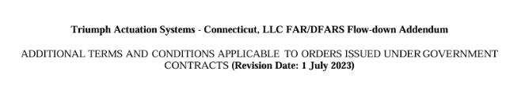
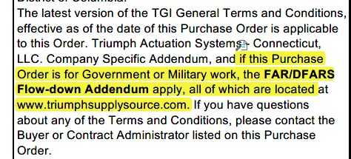
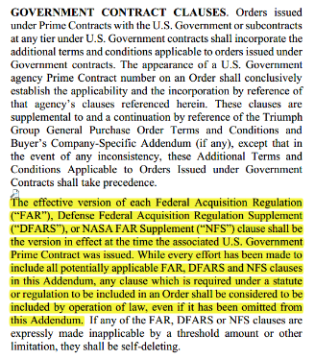
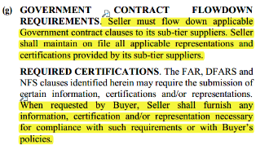
Purchase Order FAR/DFARS Flow-downs
Sample FAR/DFARS Flow-down Addendum
Sample Purchase Order

Slide 4
Existing Cybersecurity Requirements
FAR 52.204-21
  Safeguard Federal Contract Information (FCI) that is processed, stored, or transmitted through a contractor/subcontractor internal information system or network by implementing the specified basic cybersecurity controls
FAR 52.204-25
  Prohibits federal contractors from using or purchasing certain telecommunications and video surveillance equipment and services
DFARS 252.204-7012
  Safeguard Department of Defense (DoD) Controlled Unclassified Information (CUI) that resides on or is transiting through a contractor/subcontractor internal information system or network by implementing NIST SP 800-171 at a minimum
  Promptly report cyber incidents that affect CUI or the contractor/subcontractor’s ability to perform requirements designated as operationally critical; to support notifying DoD within 72 hours
DFARS 252.204-7016
  Prohibits DoD contractors from using or purchasing certain telecommunications and video surveillance equipment and services
DFARS 252.204-7019
  Implement DFARS clause 252.204-7012 and have at least a ‘Basic’ NIST SP 800-171 DoD Assessment that is current (i.e., not more than three (3) years old unless a lesser time is specified in the solicitation) posted in SPRS
DFARS 252.204-7020
  Provide Government access when necessary to conduct or renew a higher-level Assessment
  Include requirements of the clause in all applicable subcontracts and ensure applicable subcontractors can conduct and submit an Assessment

Slide 5
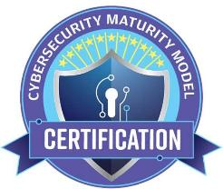
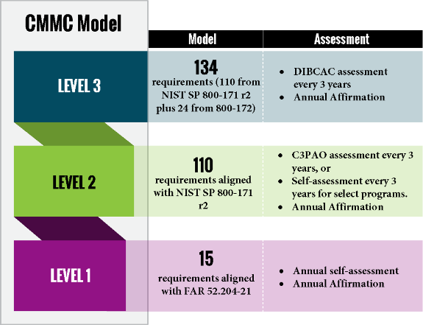
Future Cybersecurity Requirements
CMMC is an assessment methodology to determine whether a prospective contractor has implemented cybersecurity protections necessary to adequately safeguard DoD information.
DFARS 252.204-7021
Cybersecurity Maturity Model Certification (CMMC) Requirements
Requirement: The contractor shall have a current (i.e., not older than 3 years) CMMC certificate at the CMMC level required by the contract and maintain the CMMC certificate at the required level for the duration of the contract.
If you are unable to obtain the specified certification level required for a contract, the contract cannot be awarded.

Slide 6



To Report a Cyber Incident
If you experience a cyber related incident:
Notify TRIUMPH as soon as possible.
  Your TRIUMPH Supply Chain Representative
  TRIUMPH Cybersecurity Team: TGI-EnterpriseSecurity@triumphgroup.com
Follow other customer and regulatory reporting requirements.
  DFARS 252.704-7012 clause requires a DoD-approved medium assurance certificate to “rapidly report” cyber incidents to the DoD within 72 hours

Slide 7

Top Cybersecurity Best Practices to Reduce Risk
Use Strong Passwords
Implement Multifactor Authentication (MFA)
Regularly Update Equipment, Firmware & Software
User Education and Training
Utilize Encryption
Backup Data
Engage in Collaboration & Information Sharing
Segment the Network
Institute Role-based Access Control
Implement Traffic Filtering & Rate Limiting
Source: Cybersecurity & Infrastructure Security Agency (CISA) (December 2024)

Slide 8

Cybersecurity Resources
CMMC 2.0: https://dodcio.defense.gov/CMMC/
Cyber AB: https://cyberab.org/
ND-ISAC – National Defense Information Sharing and Analysis Center: https://ndisac.org/
CISA – Cybersecurity & Infrastructure Security Agency: https://www.cisa.gov/
Microsoft Digital Defense Report: https://www.microsoft.com/en-us/security/security-insider/intelligence-reports/microsoft-digital-defense-report-2024
Defense Industrial Base (DIB) Sector Coordinating Council (SCC) Cyber Assist: DIB SCC CyberAssist

Slide 9
Helpful Resources
TRIUMPH Portal- Supplier Provisions: www.triumphsupplysource.com
FAR/DFARS Links- ACQUISITION.GOV:
  https://www.acquisition.gov/far/52.204-21
  https://www.acquisition.gov/far/52.204-25
  https://www.acquisition.gov/dfars/252.204-7012-safeguarding-covered-defense-information-and-cyber-incident-reporting.
  https://www.acquisition.gov/dfars/252.204-7016-covered-defense-telecommunications-equipment-or-services%E2%80%94representation.
  https://www.acquisition.gov/dfars/252.204-7019-notice-nistsp-800-171-dod-assessment-requirements.
  https://www.acquisition.gov/dfars/252.204-7020-nist-sp-800-171dod-assessment-requirements.
  https://www.acquisition.gov/dfars/252.204-7021-cybersecurity-maturity-model-certification-requirements.

