Slide 1
2023 Supplier Forum
Supply Chain & Supplier Quality

Slide 2
AGENDA
TOPIC | PRESENTER | FUNCTION
WELCOME | DEB TRAILOR | Director, Supplier Performance
SUPPLIER QUALITY ASSURANCE MANUAL (SQAM Updates) | ALMA PALMER | Manager, Quality Management System
SUPPLIER PORTAL ENHANCEMENTS | MATT WILSON | Supplier Portal Administrator
TRIUMPH GROUP GENERAL PO TERMS & CONDITIONS | APRIL PARNELL | Director, Supply Chain Contracts and Compliance
ANNOUNCEMENTS, SUPPLIER ACTIONS & QUESTIONS | DEB TRAILOR

Slide 3
SUPPLIER QUALITY ASSURANCE MANUAL (SQAM) – Revision F
Last Revision: 2017
Major Revision:
AS9100 Requirements clarification, structure alignment & language clarification
Removed duplicate requirements
Removed non-supplier and Triumph company specific requirements
Added supplemental requirements to align with Customer and Industry Standards
Minor changes to SQAM will be numerical e.g., SQAM F.1
Support Tools:
Compliance Matrix to support implementation and understanding
Key Changes Summary Document
New Revision Effective: June 1, 2023

Slide 4
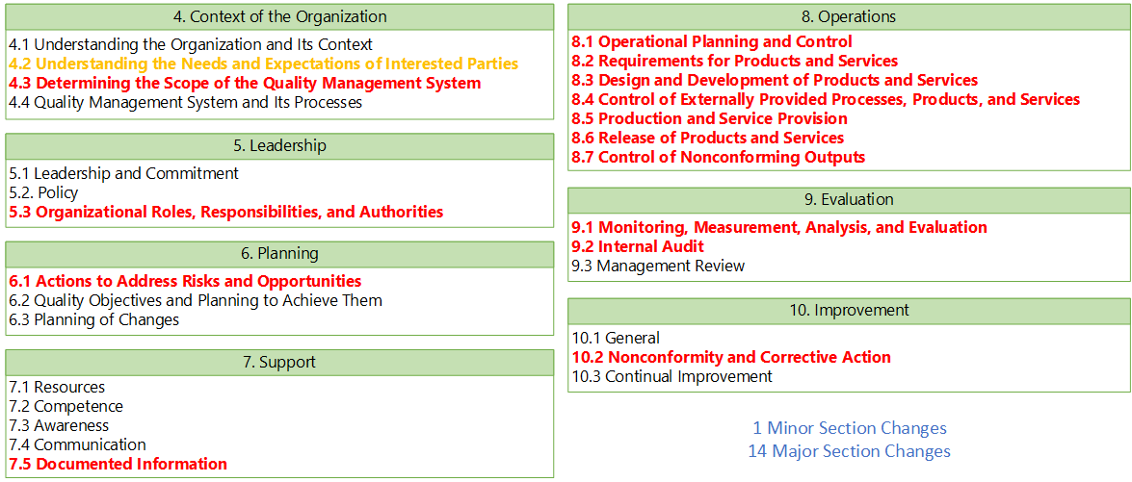
SUMMARY OF SQAM CHANGES

Slide 5
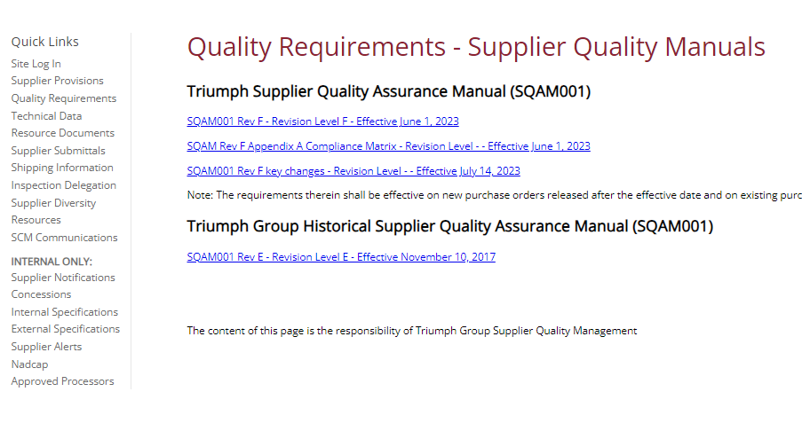
QUICK LINKS SUPPLIER PORTAL RESOURCES- SQAM ACCESS

Slide 6
SUPPLIER PORTAL ENHANCEMENTS
Noteworthy Changes to Supplier Portal
On-Time In Full (OTIF)
Data contest changes
Delivery metrics change
Supplier Risk Score/Scorecards
Risk Score includes delivery elements and business impact
Scorecards distributed monthly
Supplier's ability to update contacts and users
Suppliers have ability to designate contacts for procurement & quality
Supplier Submissions and Notifications back to Triumph
Automation detects and notifies when QMS/NADCAP certificates are expiring

Slide 7
OTIF OVERVIEW
On Time Delivery
On Time In Full
Calculation:
Total # On Time Units
Total Units
Definition:
OTD is the total number of units delivered on time, divided by the total number of units shipped.
Total number of pieces delivered within +3/-7 days of Promise Date/ Original Commit Date for number of units per period (i.e. monthly).
No longer aligns with Triumph Core Value Drivers
100% On Time to Triumph Customers
Sum of OTIF Delivery Lines
Count of PO Delivery Lines
OTIF is the percentage of total number of deliveries that were complete and on time per the Customer Agreement or Purchase Order.
Total On-Time Receipts is the Total number of pieces delivered within +3/-7 days of Promise Date/ Original Commit Date for each PO line.
OTIF is the Total On-Time Receipts within 5% of the total quantity ordered for that delivery line.
OTIF is ALL or NOTHING– Known as Perfect Order Efficiency
OTIF Includes The Arrears (Any Open POs from previous months)
OTIF metric ensures Triumph receives ALL of the parts needed, WHEN they are needed

Slide 8
SUPPLIER SCORECARD

Slide 9
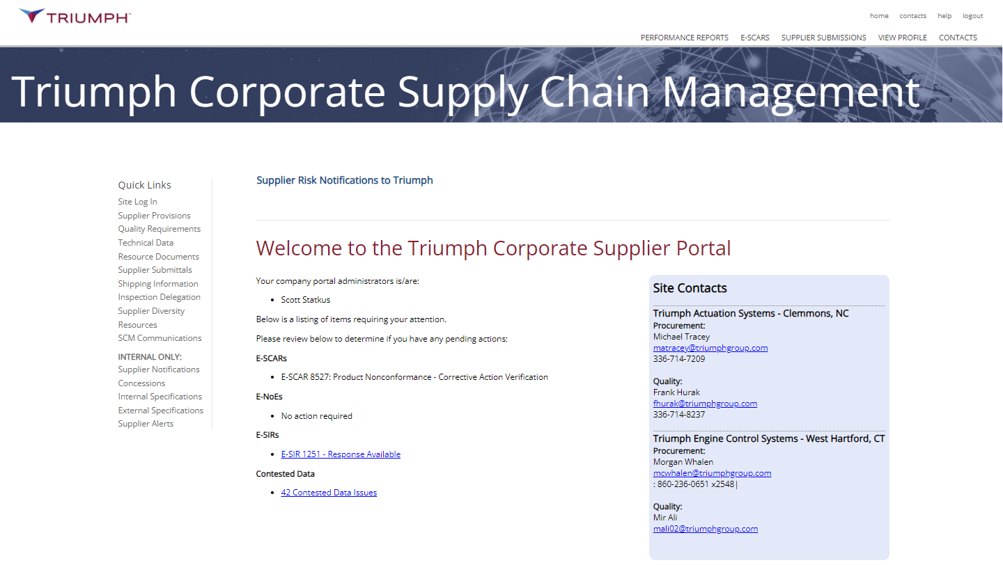
SUPPLIER PORTAL OVERVIEW
Reporting, Profile and Notification Functions
Provisions and Quality Requirements
Procedures and Training Documents
Contacts for each Triumph site doing business
Notices and Supplier Alerts
Open Items
*Access Instructions will be resent
*New Accounts w/no primary – contact Triumph rep

Slide 10
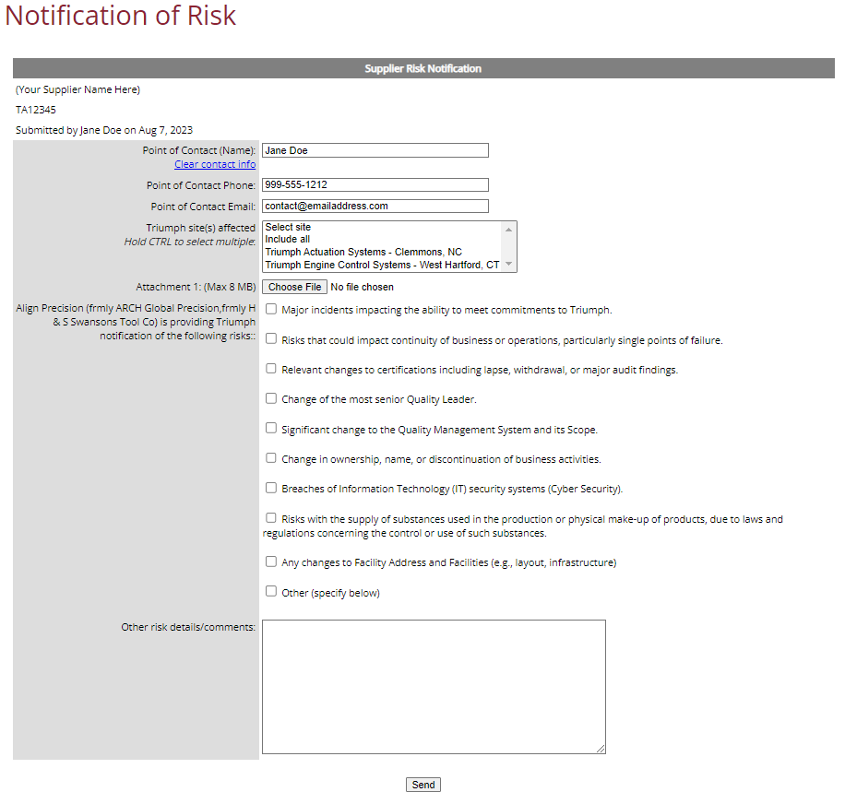
SUPPLIER SUBMISSIONS
Supplier Submissions include E-SIRs, E-NOEs, Risk Notifications and Supplier Concessions(coming soon)
A Risk Notification is any non part-affecting incident at your company representing risk

Slide 11
TRIUMPH GROUP GENERAL PURCHASE ORDER TERMS & CONDITIONS
RELEASE CHANGES SUMMARY
Triumph Group General Purchase Order Terms and Conditions
(Revision Date: 01-31-2023)
Export Compliance revisions added to Section 3 and 22 to textualize various Codes of Federal Regulation and Export/Import requirements.
Return Goods/Material Authorization (“RGA/RMA”) language added within Section 5 (Non-Conforming Products) and Section 6 (Warranty).
Security control requirement for Federal Contract Information in accordance FAR 52.204-21 language added to Section 18.
DPAS Regulation language added to Section 21, for when a priority rating is included on an Order.

Slide 12
ANNOUNCEMENTS
Triumph 2023 Supplier Conference
December 5th, 2023
Location: Marriott Dallas Las Colinas, 223 W Las Colinas, Irving, TX 75039
Theme: Taking Flight Together
Monday – Dec 4th – Reception 6:30 pm and Dinner from 7-9 pm
Tuesday – Dec 5th – 8 AM – 4 PM
Supplier Participation by Invitation Only

Slide 13
SUPPLIER ACTIONS & QUESTIONS
Triumph Supplier Actions:
Confirm Lead-times and communicate to Triumph so that PO placement is consistent between Triumph & Supplier
Confirm raw material lead-time and availability
Confirm outside processing lead-time and areas of expedite
Notify Triumph procurement if/when firm PO coverage is necessary given lead-times and to secure capacity
Contact Triumph if alternate materials/processing are to be proposed so that we can work with the customers to review and approve
THANK YOU FOR ALL YOU DO FOR TRIUMPH!
QUESTIONS?

