Slide 1



Strategic Commodity Review
Commodity:
By:
Site:
Date:
Form SCMP 7.6 (b) Strategic Review Template - Revision A Effective Date 09/1/2022

Slide 2
Executive Summary
FYXX
Spend: $
No of Suppliers:
FYXX
Spend: $
No of Suppliers:
OTIF: %
Quality: %
Supplier by FYXX Spend (top 80%)
Vendor | FYXX Spend
Overall Strategy statement
Form SCMP 7.6 (b) Strategic Review Template - Revision A Effective Date 09/1/2022

Slide 3
Transformation Initiatives – Short Term
Form SCMP 7.6 (b) Strategic Review Template - Revision A Effective Date 09/1/2022

Slide 4
Commodity Transformation
Current State:
Productivity
What does the current state look like? (Long tail suppliers? Single sourcing? LCC $ spend)
Cash, Quality, Delivery
DPO
OTIF
Savings
Contract Coverage
(Drivers of poor performance)
Future State
(1-3 yrs):
Productivity
What actions are needed to transform (part family strategies? Exit suppliers? LCC?)
Cash, Quality, Delivery
DPO
OTIF
Savings
LCC %
Contract Coverage
Ideal State
(3-5 yrs):
Productivity
What actions will be completed and what will that do to the commodity?
Cash, Quality, Delivery
DPO
OTIF
Savings
LCC %
Contract Coverage
Form SCMP 7.6 (b) Strategic Review Template - Revision A Effective Date 09/1/2022

Slide 5
Part Families
Tag Line​
Form SCMP 7.6 (b) Strategic Review Template - Revision A Effective Date 09/1/2022

Slide 6
Spend Breakdown
Tag Line
Form SCMP 7.6 (b) Strategic Review Template - Revision A Effective Date 09/1/2022

Slide 7
Supplier Dashboard
Actions to improve
Tag Line
Form SCMP 7.6 (b) Strategic Review Template - Revision A Effective Date 09/1/2022

Slide 8
Spend Rationalization – Exit Suppliers
Tag Line
Form SCMP 7.6 (b) Strategic Review Template - Revision A Effective Date 09/1/2022

Slide 9
Risk Cube
II = poor performance: ok relationship & no price risk
III = good performance: price/relationship risk, or capacity issues
IV = poor performance: price/relationship risk, or capacity issues
Total: XX
Total: XX
II
I
Actions to improve
Growth Readiness
Capacity/Relationship/Contractual Risk
Total: XX
Total: XX
IV
III
PPM > XX or X Events
OTD < XX%
PPM > XX or X Events
OTD >XX%
Quality Performance
Tag Line
Form SCMP 7.6 (b) Strategic Review Template - Revision A Effective Date 09/1/2022

Slide 10
SWOT Analysis
Strengths
Weaknesses
Product Knowledge
Developing commodity buying teams
Strong key supplier relationships
Overall good delivery and quality performance
Strong suite of mature product lines
NPI pipeline improving
TGI Strategic Sourcing Group
COVID business impact
Limited relationship with supply base
High inventory positions
Supplier capacity & readiness post-COVID
High management of Outside Processes
Sample
Opportunities
Threats
Increase LTA coverage
LCC Sourcing
Strategy to increase YOY savings
Establish overall TGI strategic suppliers
Supply base consolidation
Value engineering
NPI collaboration
Economic instability and rising raw material costs
Suppliers reluctant to new agreements
Raw material & cold-start lead-time
Customer flow-down to TGI and to suppliers
Capacity in Special Process Houses
Tag Line
Form SCMP 7.6 (b) Strategic Review Template - Revision A Effective Date 09/1/2022

Slide 11
Contracts – Existing and Planned
No of Contracts in Place: X
% of Spend Under Contract: X%
Tag Line
Form SCMP 7.6 (b) Strategic Review Template - Revision A Effective Date 09/1/2022

Slide 12
Payment Terms
Tag Line
Form SCMP 7.6 (b) Strategic Review Template - Revision A Effective Date 09/1/2022

Slide 13
Savings
Savings Headwinds Net Savings Gap to Target Target
Tag Line
Form SCMP 7.6 (b) Strategic Review Template - Revision A Effective Date 09/1/2022

Slide 14
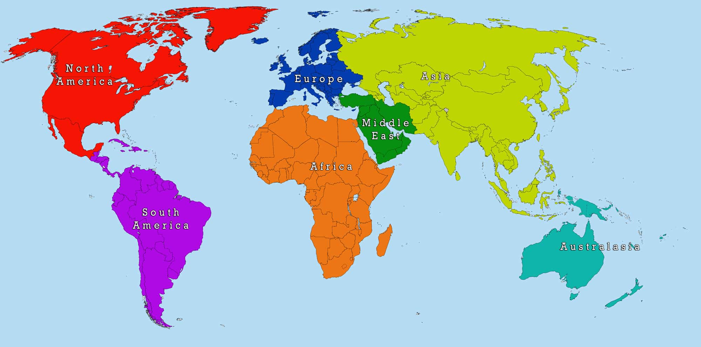
Low Cost Sourcing
Actions to improve
Europe Spend
$
North America
Spend
$
SE Asia Spend
$
Tag Line
Form SCMP 7.6 (b) Strategic Review Template - Revision A Effective Date 09/1/2022

Slide 15
Project - Template
Project Description
Outcome
Strategy Employed
Resources
Tag Line
Form SCMP 7.6 (b) Strategic Review Template - Revision A Effective Date 09/1/2022

Slide 16
Leadership Assistance Required
Tag Line
Form SCMP 7.6 (b) Strategic Review Template - Revision A Effective Date 09/1/2022

Slide 17
Back Up
Back Up
Form SCMP 7.6 (b) Strategic Review Template - Revision A Effective Date 09/1/2022

