Slide 1
Supplier SCMP 3.3 (b) Upload Scope: Instructions for accessing the supplier self assessment worksheet and upload to the TGI portal

Slide 2
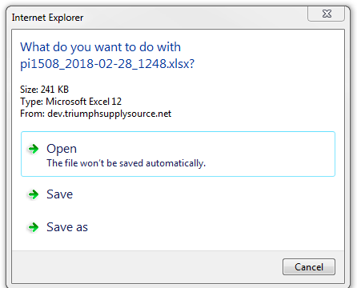
Step 1. Once logged in select “Supplier Profile”
from VIEW PROFILE sub-menu
Step 2. Once the profile appears click on hyperlink to download the Assessment workbook
Step 3. Click on “Save as”, rename file, reopen from saved location and complete the assessment

Slide 3
Step 4. When the assessment has been completed, save results, access profile in the portal, upload file using the “Browse” link. Then click on “Save” to completed the upload process.
Step 5. Once uploaded the field will reflect “yes” and the file can be accessed by clicking on the created hyperlink. If revisions are required or you wish to upload a new assessment, repeat steps 2-4.

