Slide 1
Supplier Complete Application – TSCMT 3.5 Scope: Instructions for the Supplier on accessing and completing the application

Slide 2
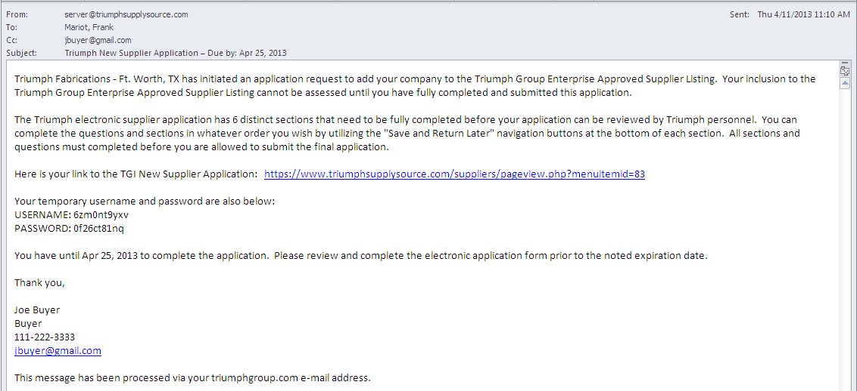
Below is the typical email that the supplier will receive. Note: the Triumph Group initiator will also receive
a courtesy copy
By clicking on the embedded link, will take you to the Portal
Home page.
Use the provided user name and password to login to the portal

Slide 3
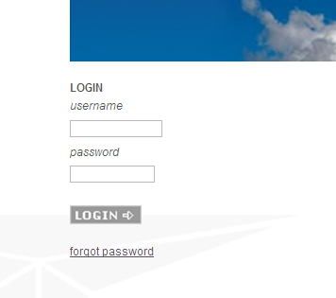
Step 1. Hover your mouse pointer over the “Site Log In” menu item. This will display the secondary menu where
You will select the “Triumph Group Suppliers Log In” menu item
Enter the user name and password that was provided in the email invitation to log into the portal

Slide 4
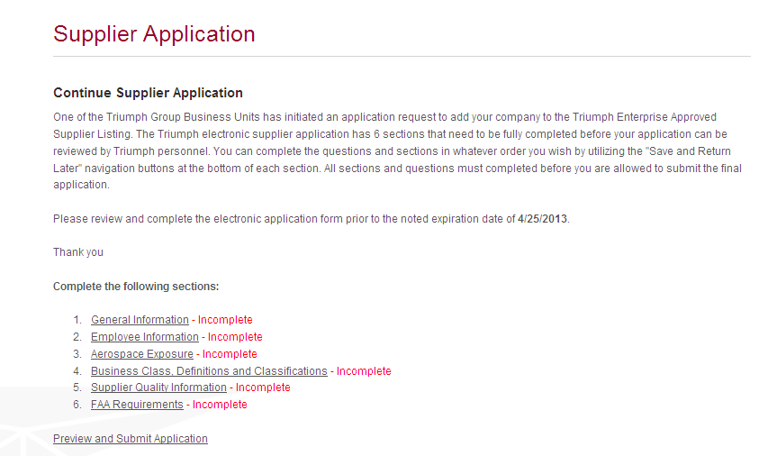
Step 2. After login, the application introduction will display with six (6) sections that will require completion.
The application will have an expiration date noted and the supplier is requested to complete the application prior
to that date.
Access each section by clicking on to the underlined section topic. You can process the application in sequence or at random. The status will show “incomplete” until the section has been fully completed.

Slide 5
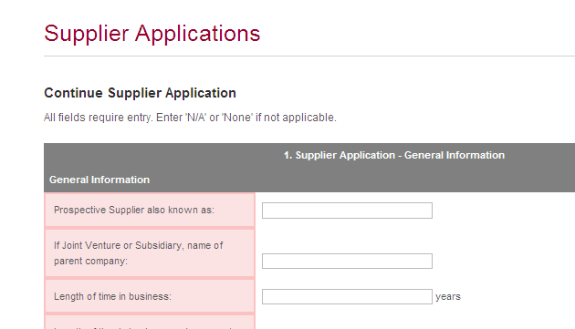
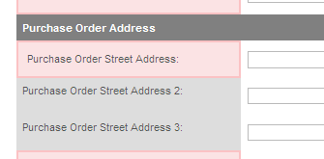
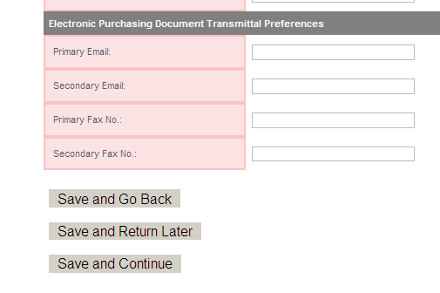
Step 3. Begin to populate respective fields with requested information. As noted at beginning of the application
all fields require an entry. Note there will be some fields highlighted in light gray that are optional.
The first section will require input of a possible three different addresses:
Purchase Order (address PO mailed to)
Manufacturing (primary mfg. facility)
Remittance (address payment mailed to)
Address 2 & 3 shown below are for additional
Information, e.g., Bldg 200, Mail Zone 1A, etc. and not other facility addresses.
At the end of each section you have three options:
Save and Go Back – this saves the info already input and goes back to the previous section
Save and Return Later – this saves the data already input and goes back to the home screen
Save and Continue – this saves the data already input and goes to next section

Slide 6
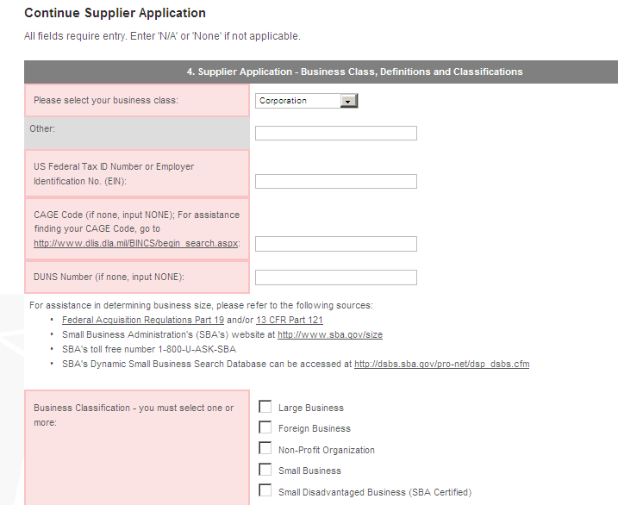
Step 4. Sections 2 & 3 are fairly self explanatory. Further instruction is provided for Section 4 below:
Select applicable class from drop down menu
Underlined text are hyperlinks that will take you to external websites to assist in determining input information if needed.

Slide 7
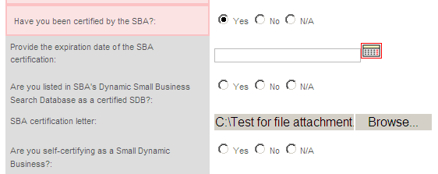
Step 4. Cont’d, Further instruction is provided for Section 4 below:
If you select “yes” for certified SBA, select the certification expiration date from the drop down calendar
Download Cert to your desktop, then:
To attach cert., click on “Browse,” locate file on desktop and select. File name will appear in dialogue box
Continue application by selecting one of three below options:

Slide 8
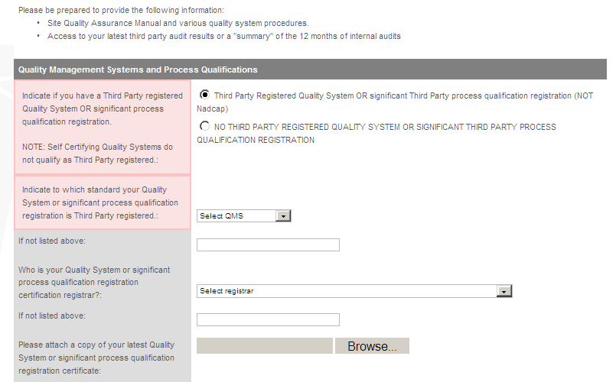
Step 5. If Triumph has already determined that the supplier has a 3rd party Quality Certificate (e.g., AS9100,
ISO2000, etc…) respond to questions noted. If the a 3rd party certificate could not be determined then the
supplier will have the option to provide that information.
If the supplier has an industry recognized 3rd party QMS accreditation then select the 1st radio button, otherwise select the 2nd one.
Selecting the 1st option will open additional fields for input.
Select the appropriate QMS system and registrar form the drop down list. If not listed then enter in fields immediately below
To attach cert., click on “Browse,” locate file on desktop and select. File name will appear in dialogue box

Slide 9
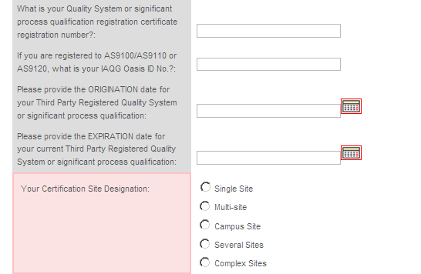
Step 5. Continue to provide requested information:
Select the applicable dates from the drop down calendar. Origination date is typically the certificate issue date.
The site designation is provided for an AS9100 certification. The definitions for these are taken from AS9104/1

Slide 10
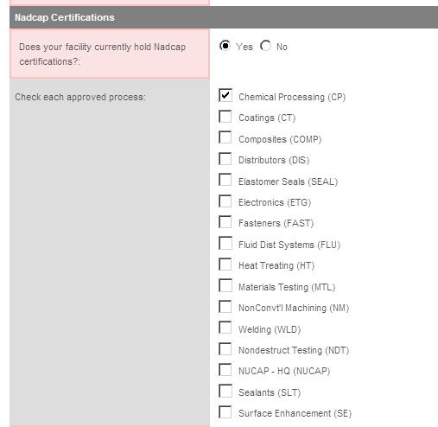
Step 5. Continue to provide requested information:

Slide 11
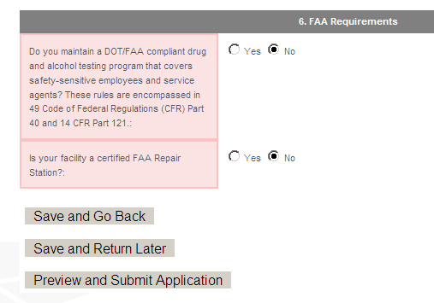
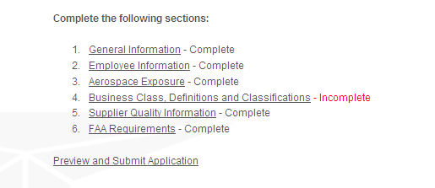
Step 6. Section 6 is fairly self explanatory. Once complete with section 6 you can save and go back,
Return later or preview and submit the application
If you select “Preview and Submit Application” and there is missing information you will receive the below message. If application is complete the complete application will display for preview and submittal – ref. step 6.
Click on “Return to Home Page….”, from the home screen click on the section that
reflects “incomplete”

Slide 12
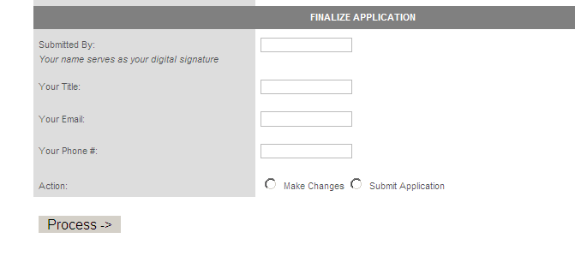
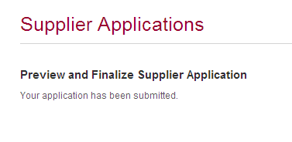
Step 7. Review application , if acceptable enter submitted by information, select “submit application” radio button
and click on “Process.” The home screen will reflect that the application has been submitted.

