Slide 1

Web Portal Training – Supplier Access/View of Quality Scorecard
Scope: Instructions on Accessing and Viewing Quality Scorecard.

Slide 2
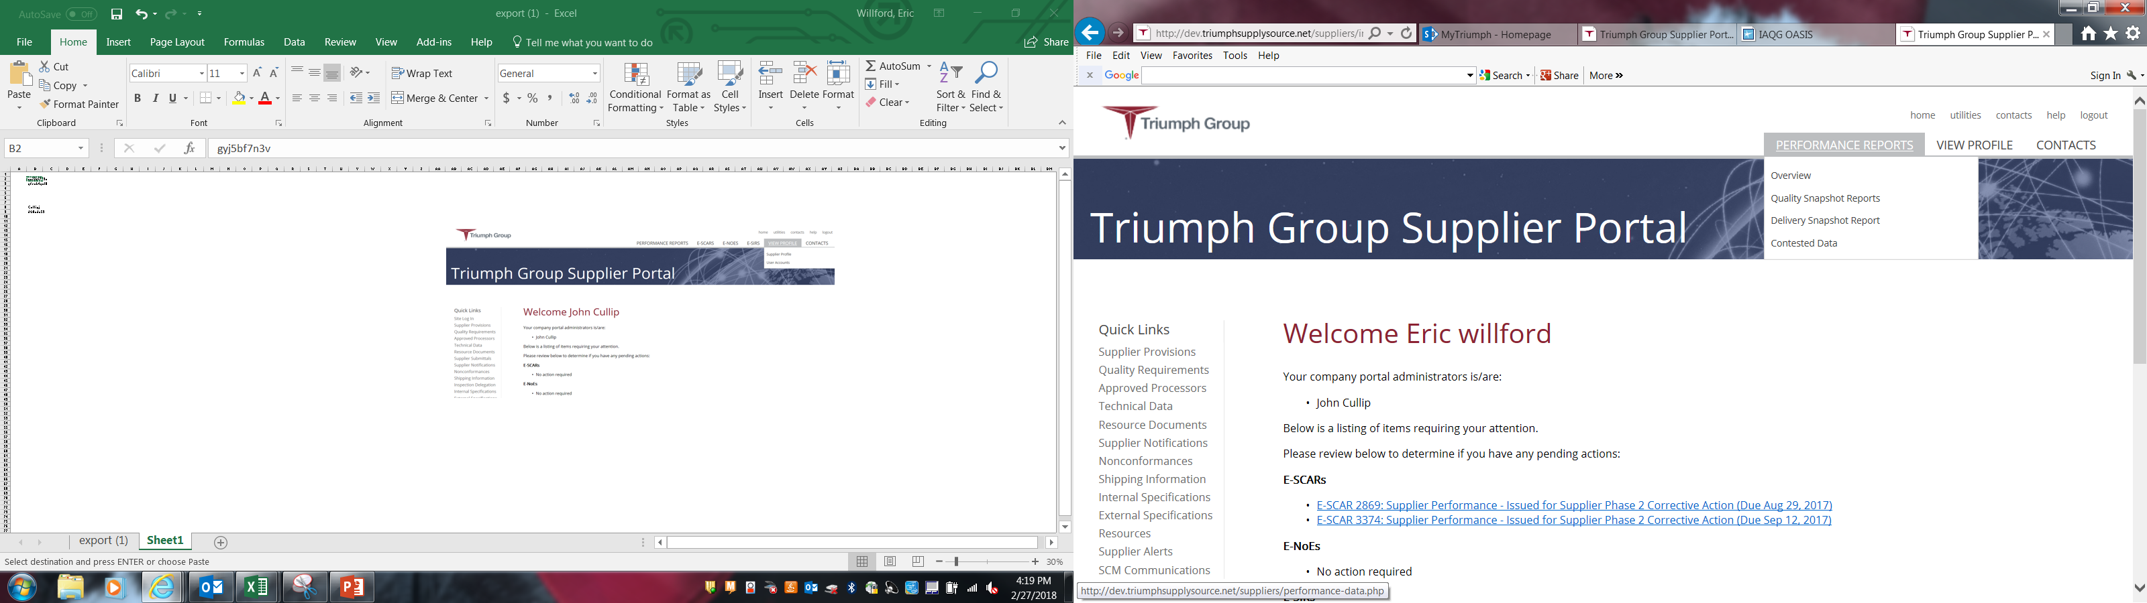
Accessing and Viewing Quality Scorecards
After Logging in, select Performance Reports
From the Sub-menu you can select:
-Overview – Describes the scoring and ratings for Quality and Delivery
-Quality Snapshot Report – Scorecard of Quality Performance
-Delivery Snapshot Report – Scorecard of Delivery Performance

Slide 3
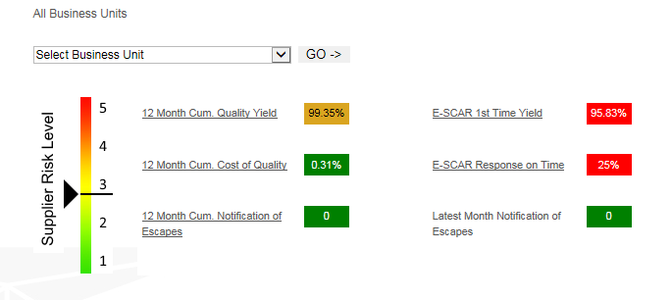
Quality Snapshot Report
Initial scorecard reflects quality performance for all TGI Business Units under contract. Select the specific BU from the drop down list if you would like to see performance for the BU and then click on Go.
The components below that are underlined are hyperlinks that will take you to the detail chart and subsequent back up data
The risk based supplier scorecard is calculated based on six independent components:
12 month Cumulative Quality Yield – examples displayed starting on slide 5
12 month Cumulative Cost of Quality - examples displayed starting on slide 11
E-SCAR 1st Time Approval Yield - examples displayed starting on slide 13
E-SCAR On-Time Response - examples displayed starting on slide 15
12 month Cumulative Notification of Escapes - examples displayed starting on slide 17
Latest Month Notification of Escape
The supplier risk level (shown ranging in value from 1 to 5, with 1 being low risk and 5 being high risk) is calculated based on evenly weighting the supplier’s performance in each of the six individual components. Note: Non-rated elements will not be factored in the risk calculation.

Slide 4
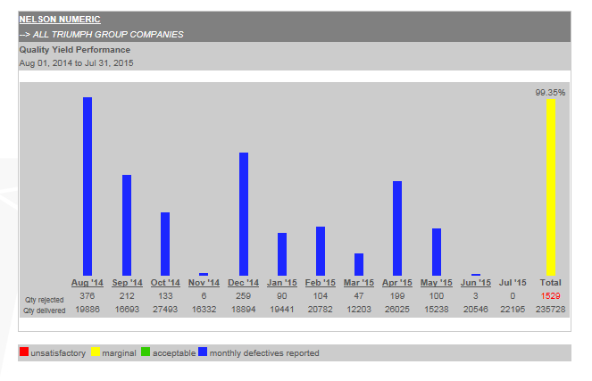
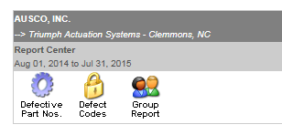
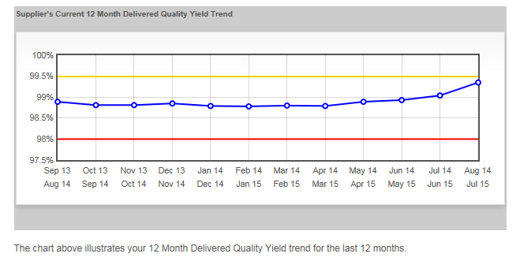
12 Month Cum Quality Yield
12 Month rolling Quality Yield Percentage bar
Bars show total rejected parts for month
Report Center - Slides 8 thru 10 displays the content for each Icon displayed here.
For Detailed List click on Month – see slide 5
12 Month Delivered Quality Yield Trend (See Slide 6 & 7)

Slide 5
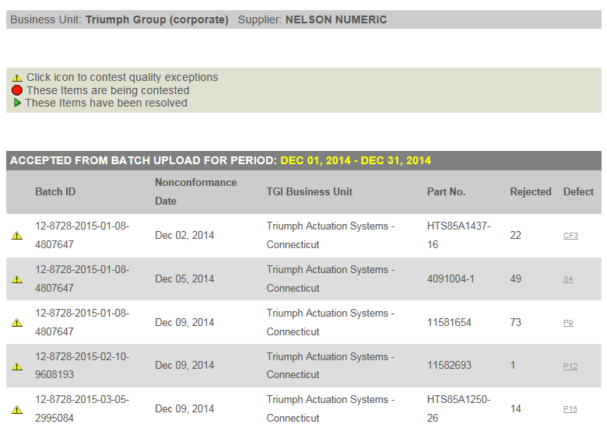
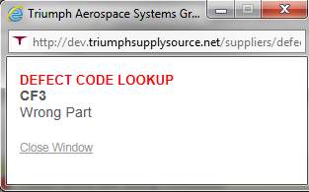
12 Month Cum Quality Yield
Detailed Monthly Report shows Batch ID #, Non Conformance Date, TGI BU, Part Number , Qty Rejected, Defect Code.
By Clicking on the Defect Code, the Code Description is Shown

Slide 6
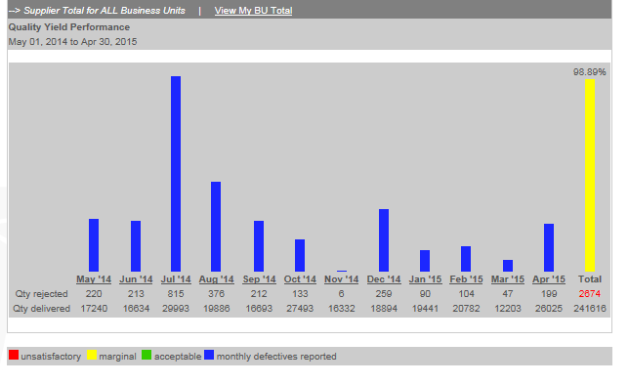
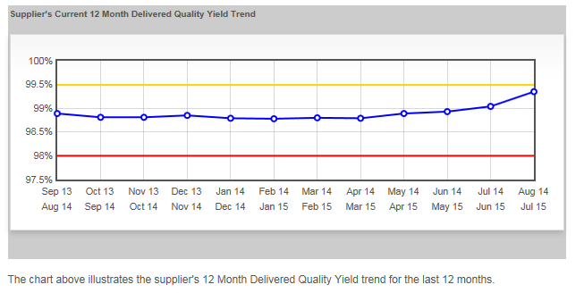
12 Month Cum Quality Yield
Clicking on the point will change the bar graph to show that time frame, ref. next slide.
By Hovering over a point on the graph you can see the Quality Yield Percent for that time frame
98.89%
May 14/Apr15 – 98.89%

Slide 7
12 Month Cum Quality Yield
The graph time frame has changed to May 2014 – Apr 2015
The Yield graph will not change.

Slide 8
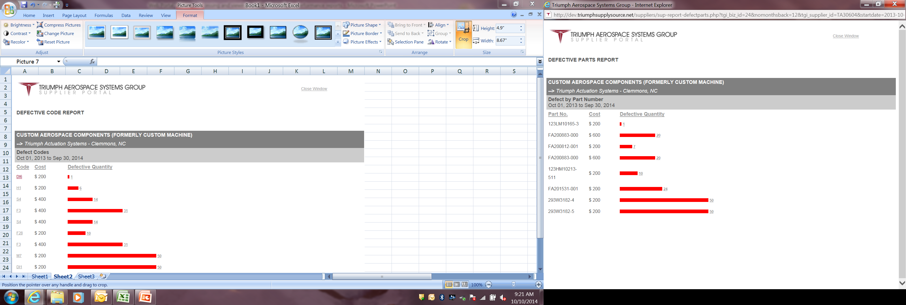
Report Center – Defective Parts Nos. Report
Defective Part Nos. Report – shows Quantity Defective by Part Number for the specified time period

Slide 9
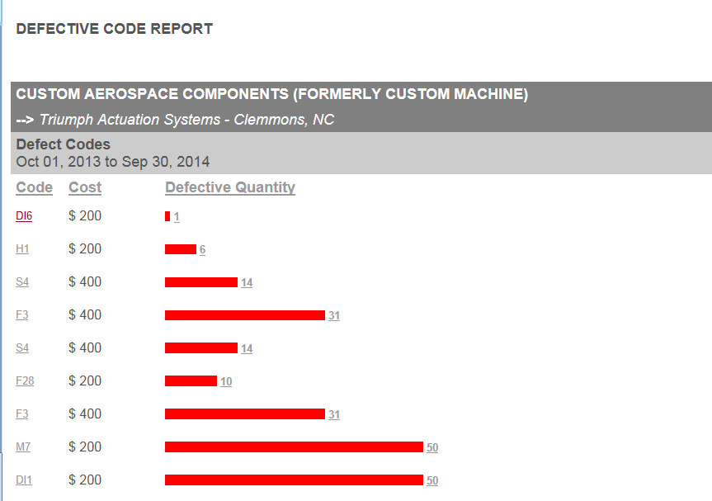
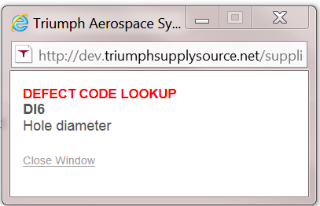
Report Center – Defect Codes Report
Defect Codes Report – shows Quantity Defective by Defect Code for the specified time period
Clicking on Defect Code provides Defect Code Description

Slide 10
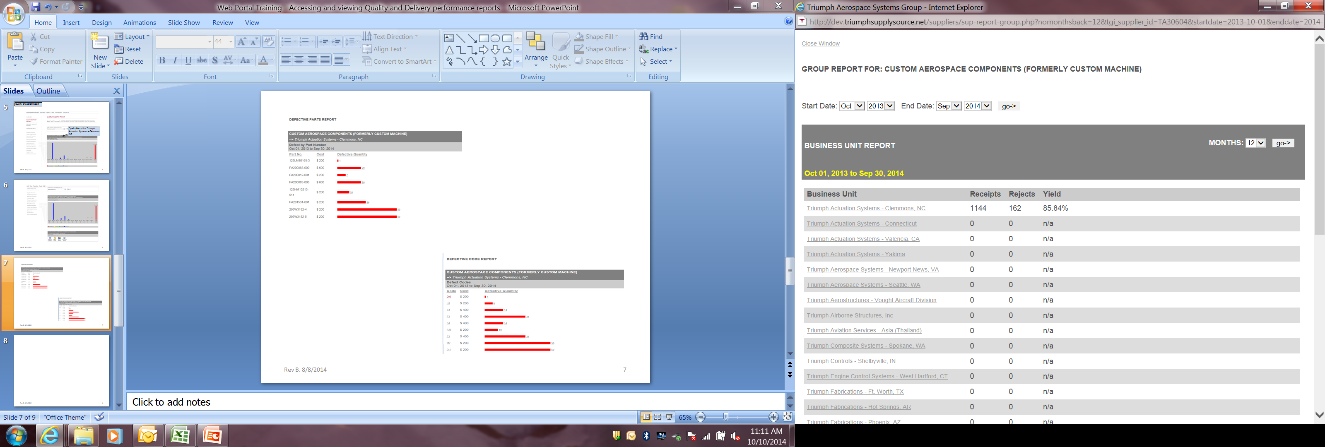
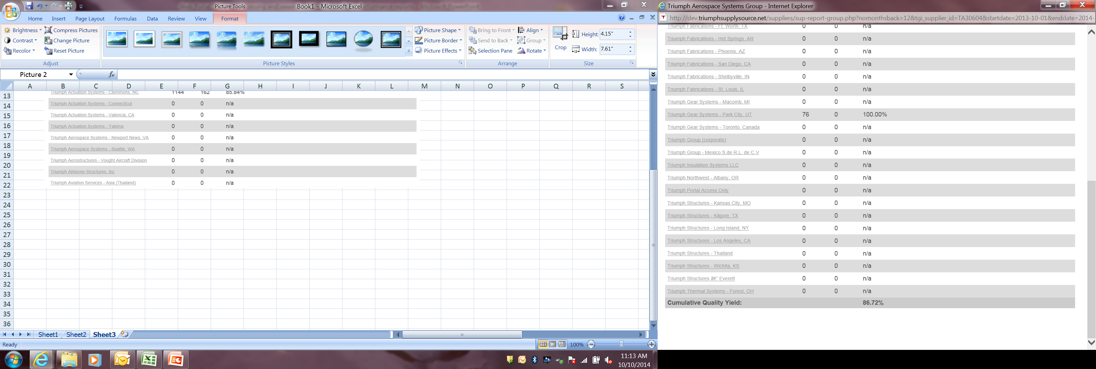
Report Center – Group Report
Group Report lists Receipts, Rejects and Quality Yield % for each using Business Unit and Cumulative Quality Yield

Slide 11
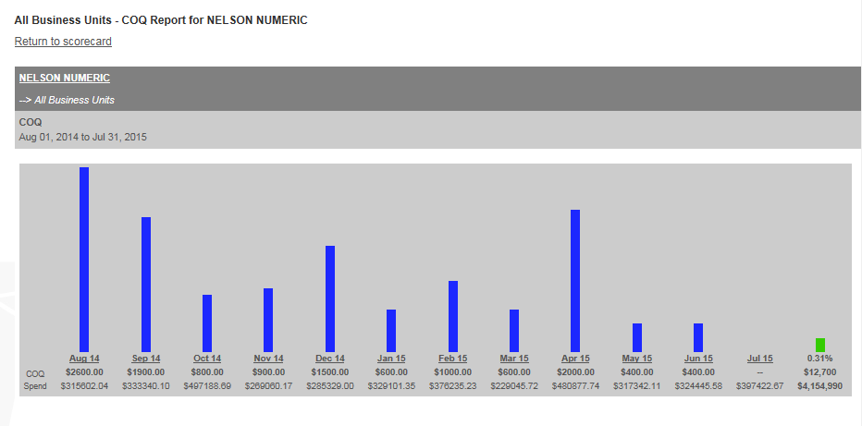
12 Month Cum Cost of Quality Chart
You can return to scorecard by clicking on link.
COQ chart displays activity by month. You can access the detail data by clicking on the underlined month link – ref. slide 12

Slide 12
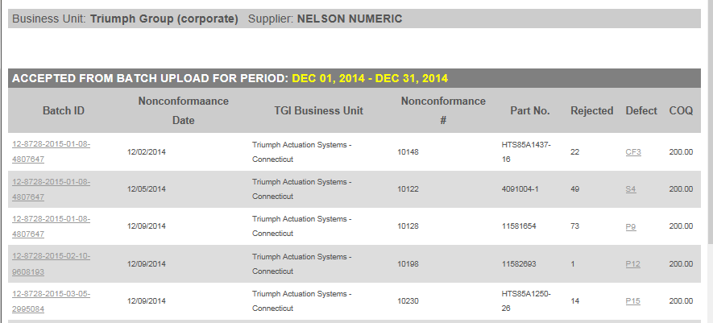
12 Month Cum Cost of Quality Chart- Detail Month data
This data reflects the rejections that drove the COQ value for the month selected.
Hyperlinks take you to the Batch data detail information or the defect description

Slide 13
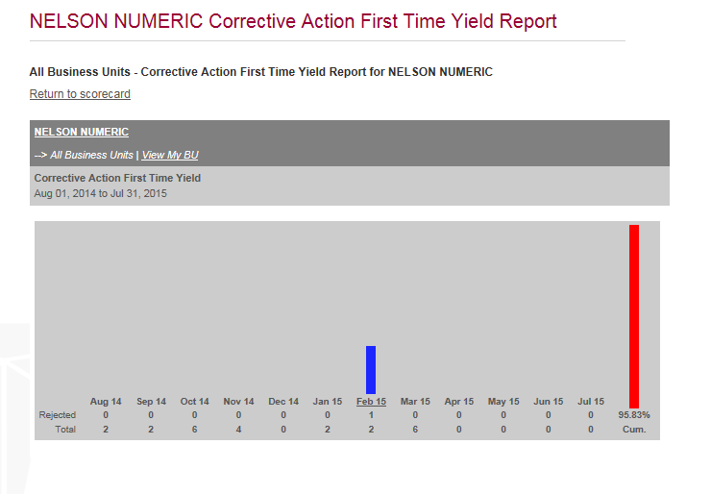
E-SCAR 1st Time Approval Yield
Clicking on the specific month will display the detail data (next slide)

Slide 14
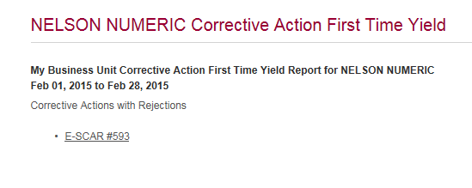
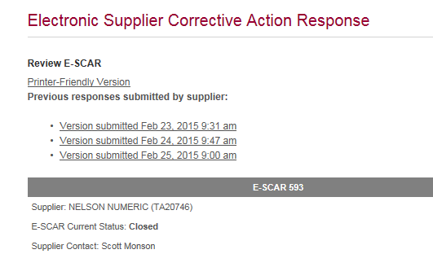
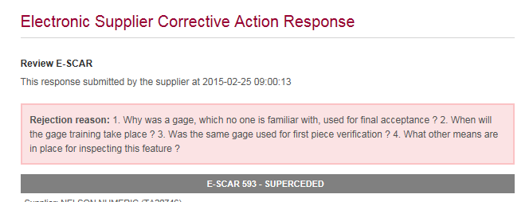
E-SCAR 1st Time Approval Yield
The E-SCAR number is displayed that drove the rejection. Clicking on it will display the E-SCAR
One of the previous versions will contain the reject reason, in this case the Feb. 25 was rejected, click to display.

Slide 15
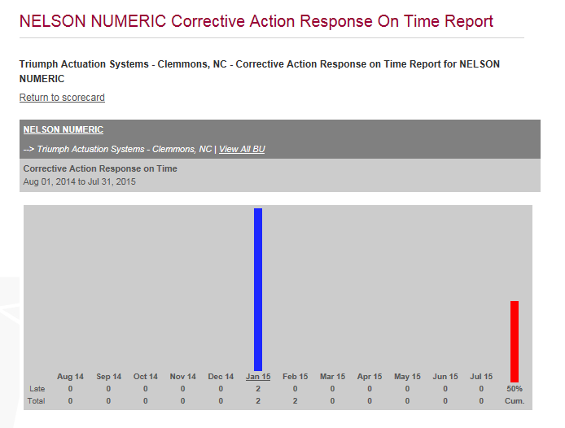
E-SCAR On-Time Response
Note: The delinquency will post to the month the E-SCAR was responded to and not when issued or due.
Clicking on the specific month will display the detail data (next slide)

Slide 16
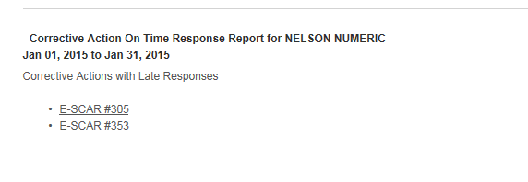
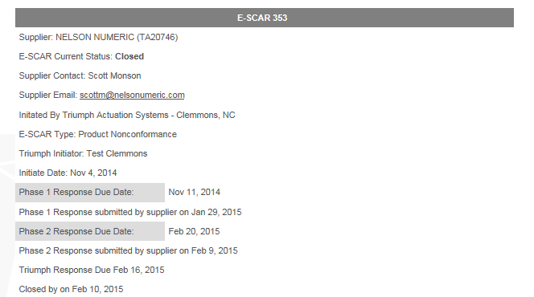
E-SCAR On-Time Response
Click on the specific E-SCAR to display. Below you will note that the Phase one response was delinquent in January.

Slide 17
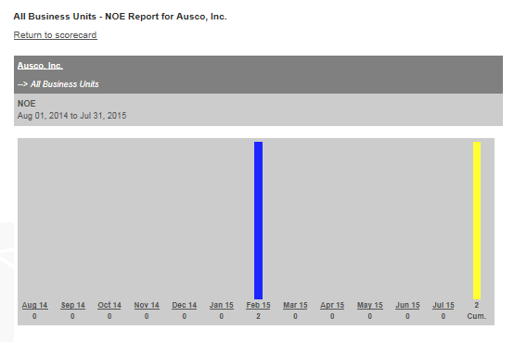
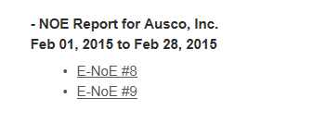
12 Month Cum Notification of Escapes
Clicking on the specific month will display the detail data.

