Slide 1

Web Portal Training – Supplier Access/View of Delivery Scorecards
Scope: Instructions on Accessing and Viewing Quality Scorecards.

Slide 2
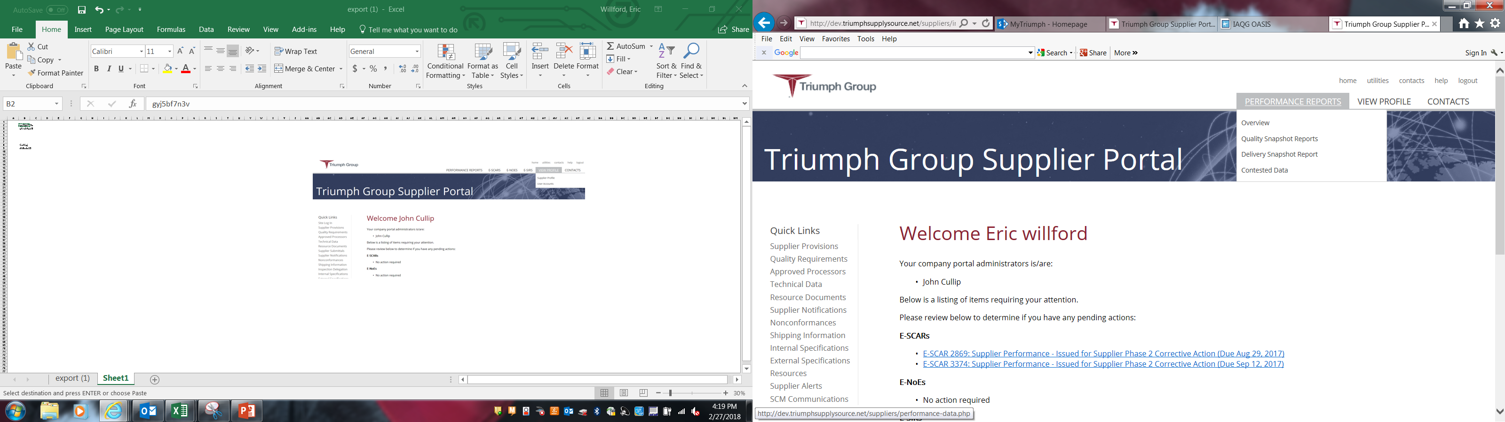
Accessing and Viewing Delivery Scorecards
After Logging in, select Performance Reports
From the Sub-menu you can select:
-Overview – Describes the scoring and ratings for Quality and Delivery
-Quality Snapshot Report – Scorecard of Quality Performance
-Delivery Snapshot Report – Scorecard of Delivery Performance

Slide 3
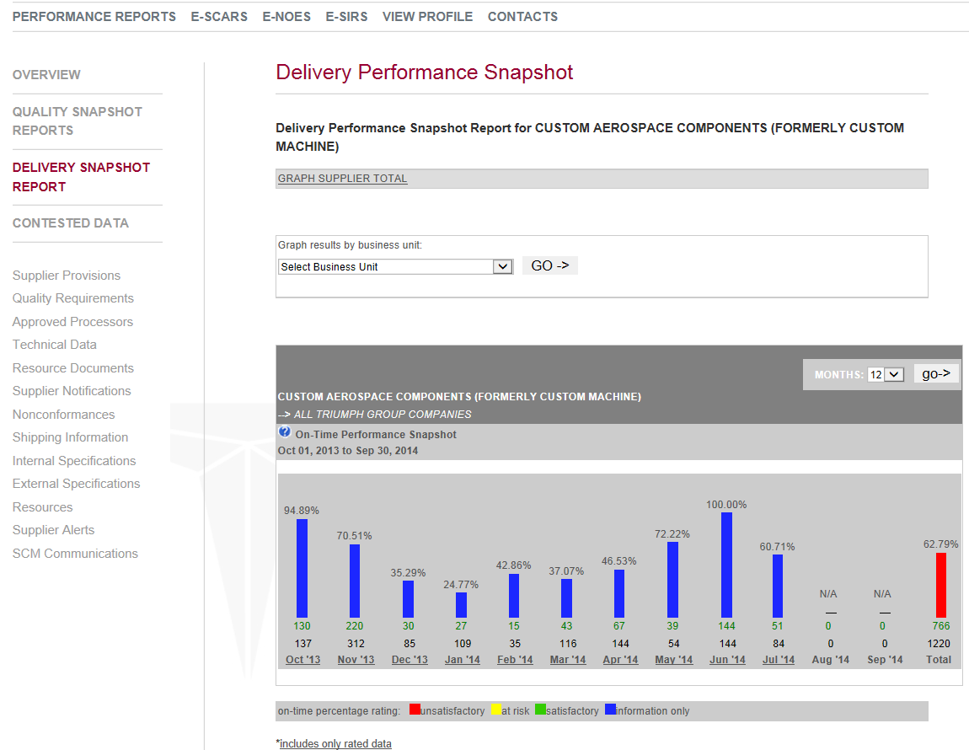
Delivery Snapshot Report
Delivery Report for All TRIUMPH GROUP COMPANIES
12 Month rolling Delivery Yield Percentage bar
Monthly Delivery Yield Percentage

Slide 4
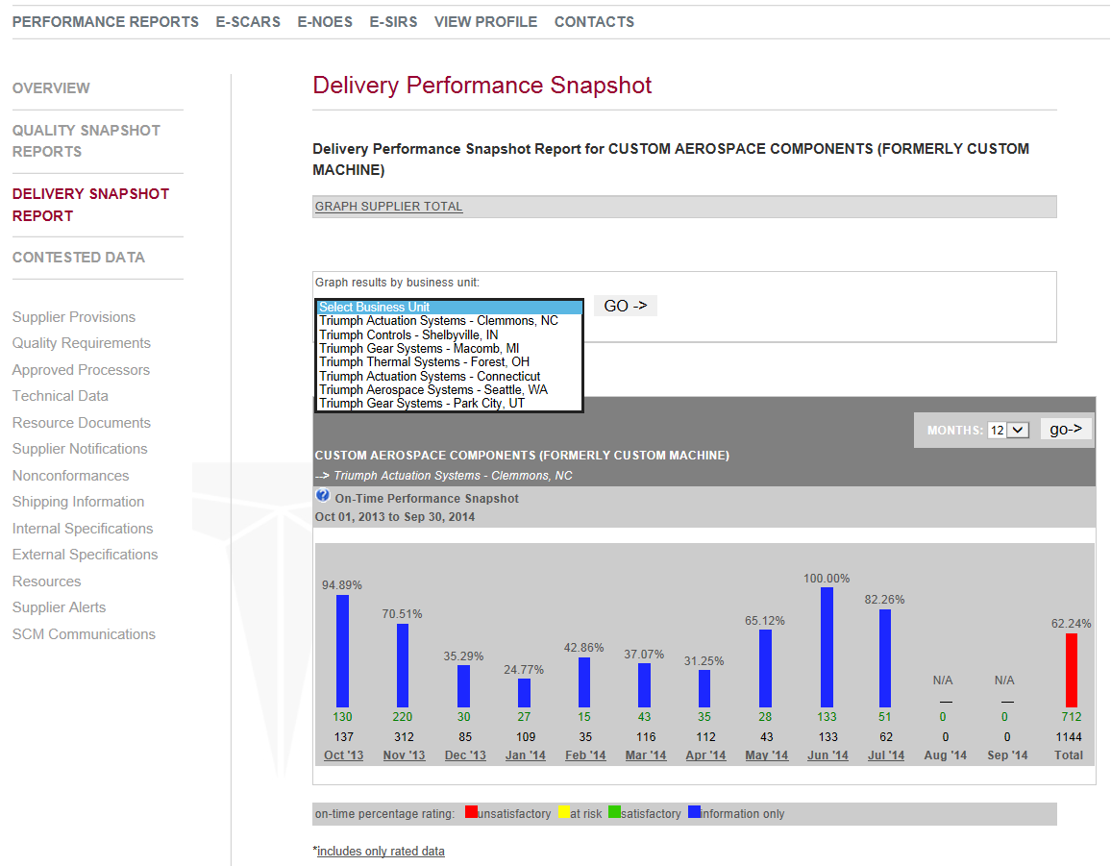
Delivery Snapshot Report
To view a Specific Business Unit: Using down arrow select the appropriate Business Unit
Delivery Report for Triumph Actuation Systems – Clemmons, NC
For Detailed List click on Month

Slide 5
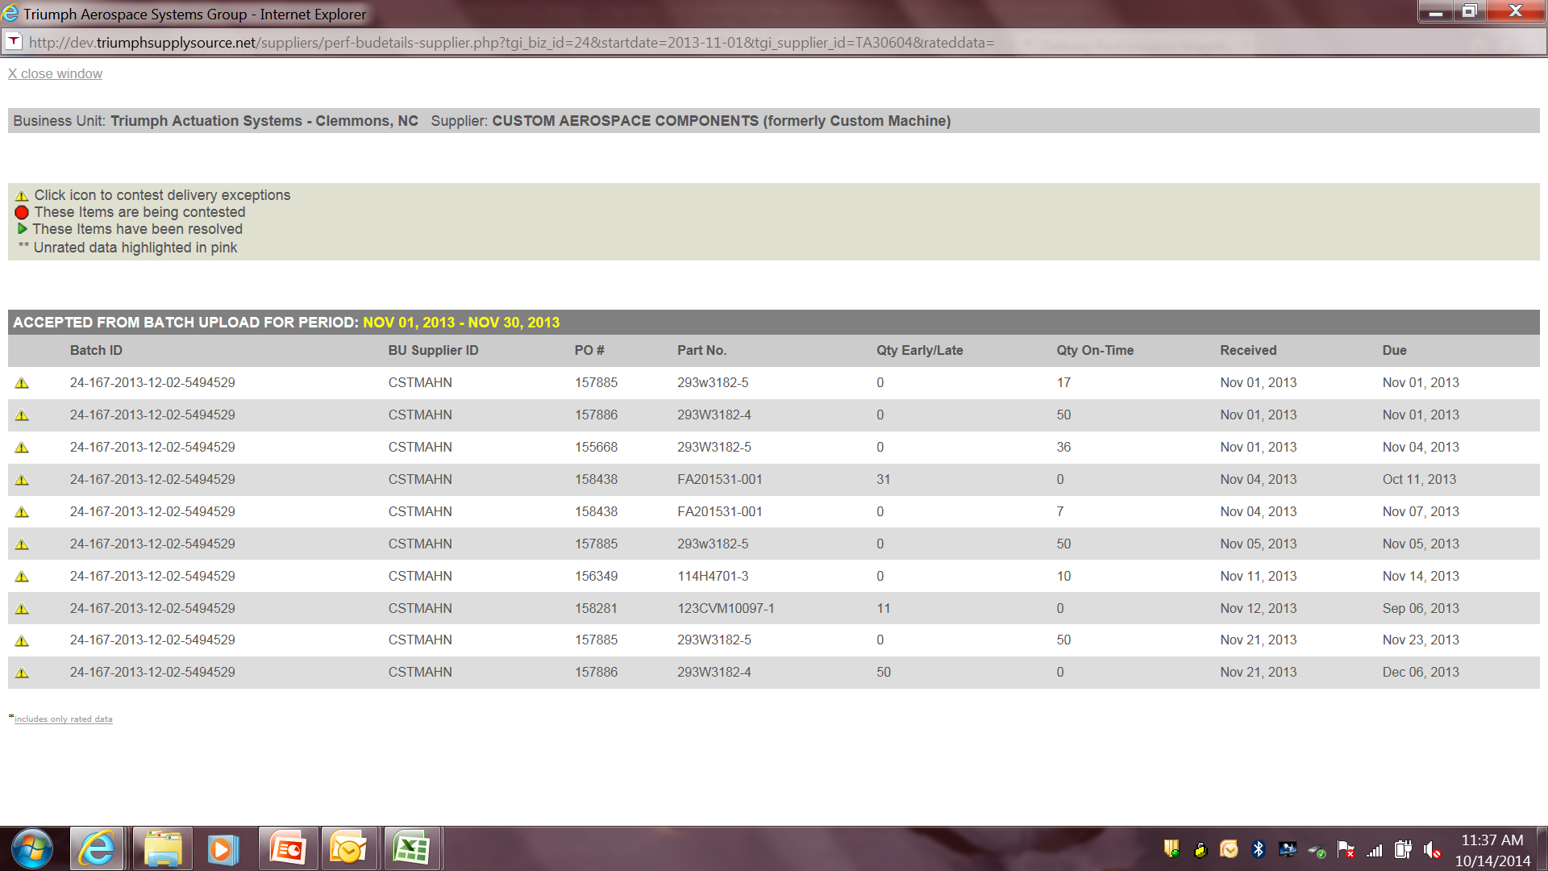
Delivery Snapshot Report
Detailed Monthly Report shows Batch ID #, BU Supplier ID, PO#, Part No., Qty Early/Late, Qty On Time, Received Date, and Due Date

