Slide 1
Web Training – Contested Quality Data Scope: Instructions for Submitting Contested Quality Data

Slide 2
Contested Quality Data
The Supplier can Contest Quality Data by selecting the Quality Snapshot Report.
SCMP 5.2 Para 7.3.2 “Within 10 working days of the issuance of the performance reports, suppliers may contest a Delivery/Quality Data by submitting an electronic appeal concerning specific issues via the triumphsupplysource.com web site.

Slide 3
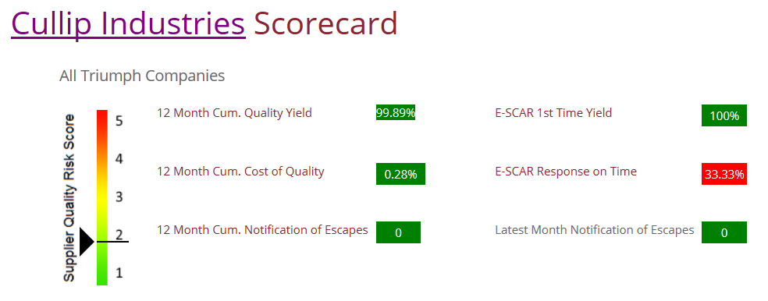
Click on 12 Month Cum Quality Yield to view Quality Yield Performance graph

Slide 4
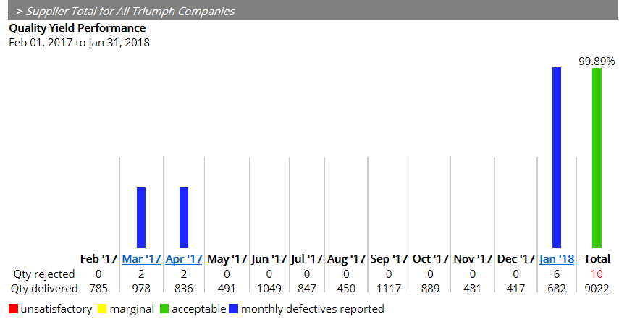
Contested Quality Data
Select Triumph Company
Select BU
Then select the month in which the non conformance occurred

Slide 5
Contested Quality Data
Select the part number

Slide 6
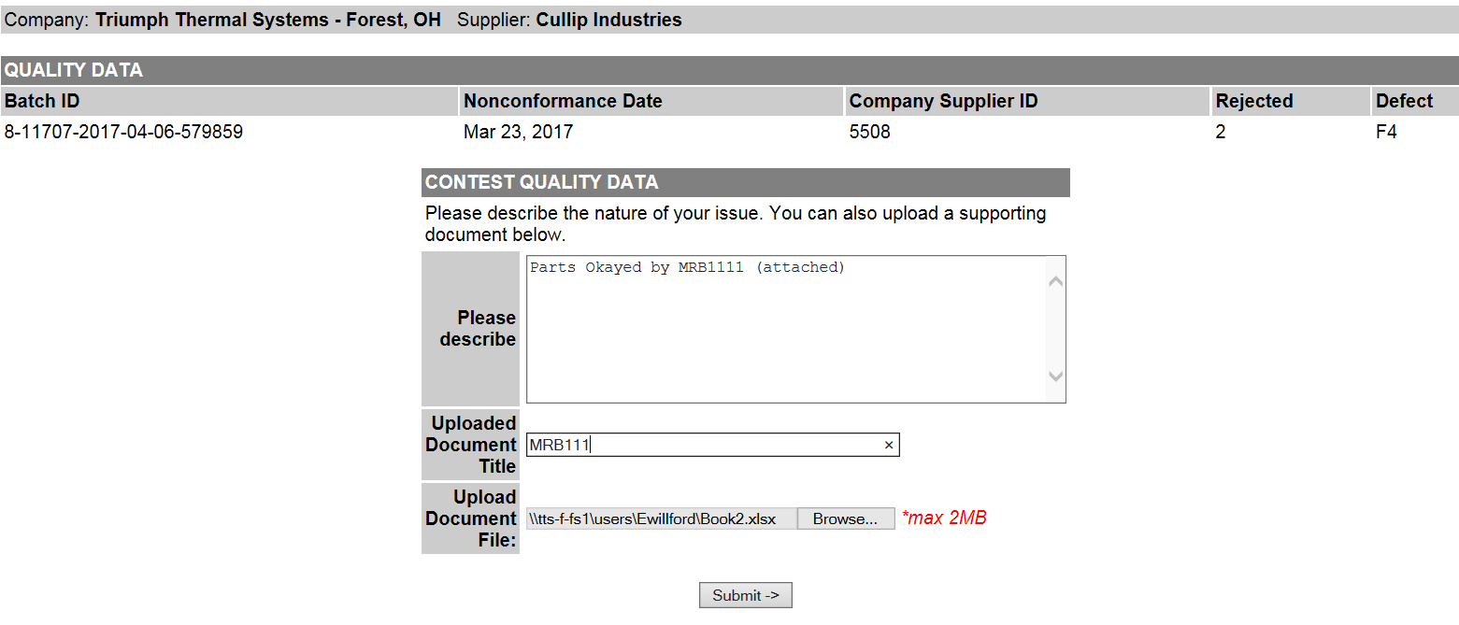
Contested Quality Data
Complete form and attach documents ,if applicable, and Submit

Slide 7
Contested Quality Data
Your submission has been sent to Triumph Administrators

Slide 8
Contested Quality Data
Notification of Contested Data will be shown on your Home Screen.
As well as the Triumph BU Quality Personnel
Click on the Hyperlink

Slide 9
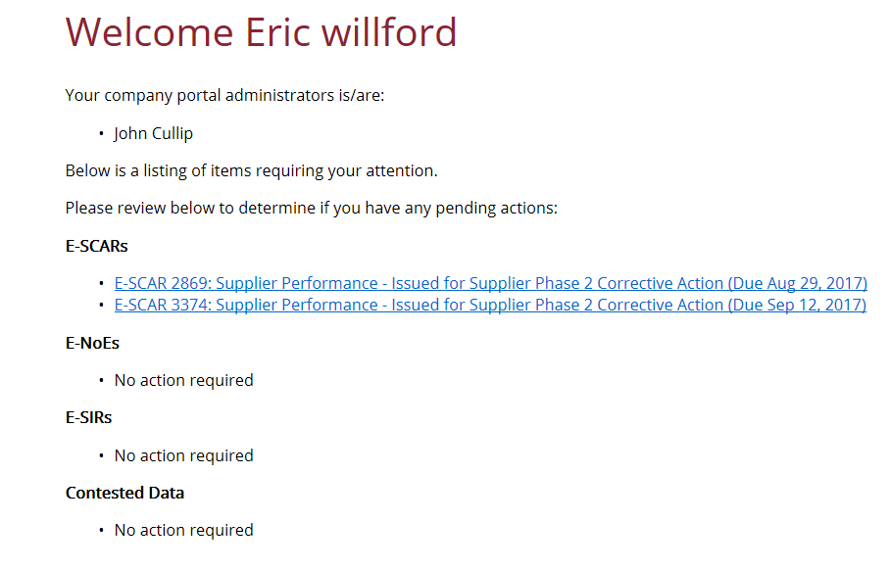
Contested Quality Data
Once Contested data has been processed, it is removed from your Home page. A separate e-mail will be sent describing disposition of contested data by TGI quality.

