Slide 1
Supplier Review E-SIR Response – TSCMT 7.6 Scope: Instructions for a supplier reviewing the information request response.

Slide 2
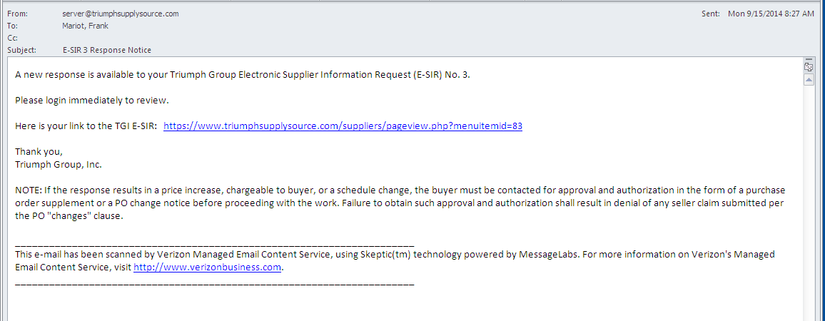
Supplier initiator will receive an e-mail notification when an E-SIR response has been provided.
A hyperlink to the TG supplier portal has been included for your convenience.

Slide 3
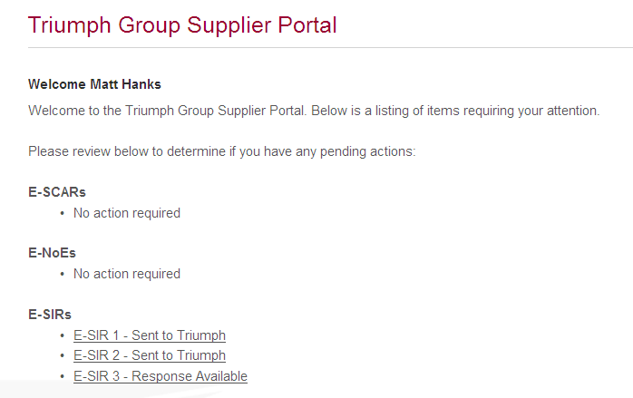
Once logged in you will see that a response has been provided for E-SIR 3, access the E-SIR by clicking on the hyperlink

Slide 4
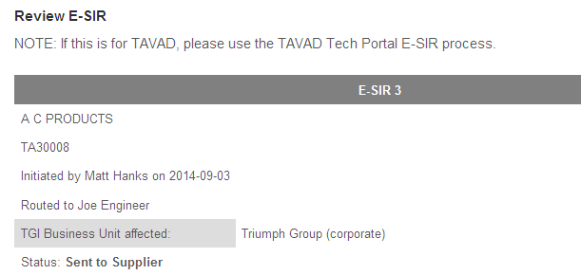
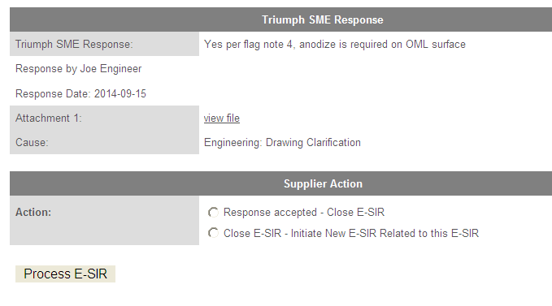
Review E-SIR response and then select appropriate action result:
If response addresses and clears the issue then select “Response accepted – Close E-SIR” and click on “Process E-SIR” link
If additional information is required, then select “Close E-SIR – Initiate New E-SIR Related to this E-SIR” and click on “Process E-SIR” link. This will open and initiate a new E-SIR application.

Slide 5
By selecting the “Manage E-SIRs” link from the E-SIRS main menu sub-menu list you can see all open E-SIRs and perform a search of all previous E-SIRs processed.

