Slide 1
Supplier Initiate E-SIR – TSCMT 7.3 Scope: Instructions for initiation of a new supplier information request

Slide 2
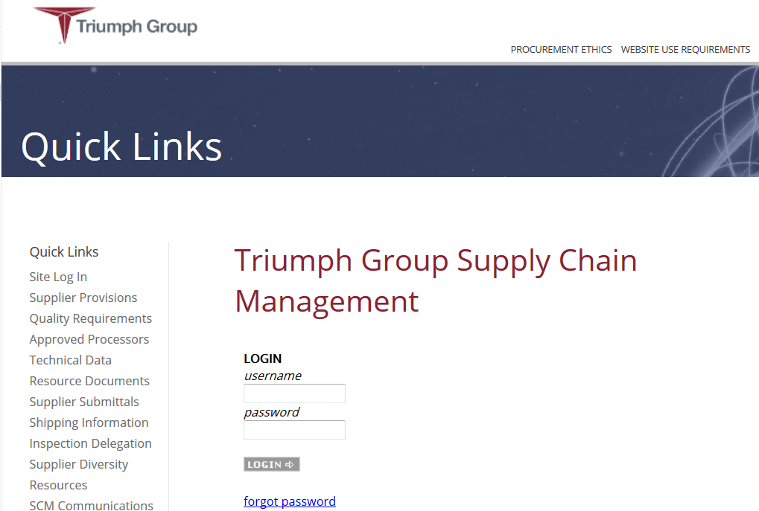
Step 1. LOGIN to supplier portal

Slide 3
Step 1. Select “New E-SIR” from E-SIRS menu

Slide 4
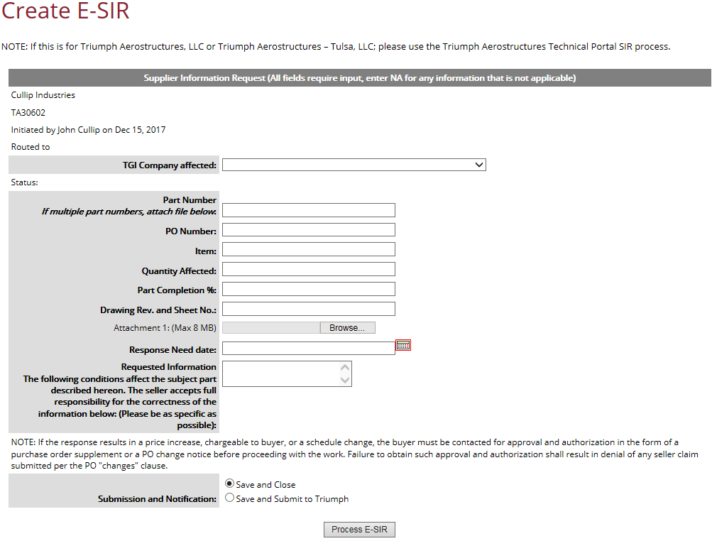
Step 2. Complete all sections of the E-SIR (enter NA as applicable)
Select the Triumph Company that you are submitting the information request to.
Enter all applicable information, Note all fields require input, enter NA for any information that is not applicable.
If not complete, select “Save and Close”, SIR will display with a saved status on suppliers home page. You will have the option to void if necessary.
If complete, select “Save and Submit to Triumph.”
Click on “Process E-SIR”
Note: E-SIR will be submitted to the Triumph Procurement contact noted on your supplier profile.

Slide 5
After submittal – the E-SIR will display on the supplier users home page, you can access it by clicking on it. Note: you will not be able to void after submittal. Contact the procurement agent if sent in error or you would like it sent back to add/modify any content.

