Slide 1

Supplier Initiate E-NoE – TSCMT 7.1
Scope: Instructions for initiation of a new supplier notification of escape

Slide 2
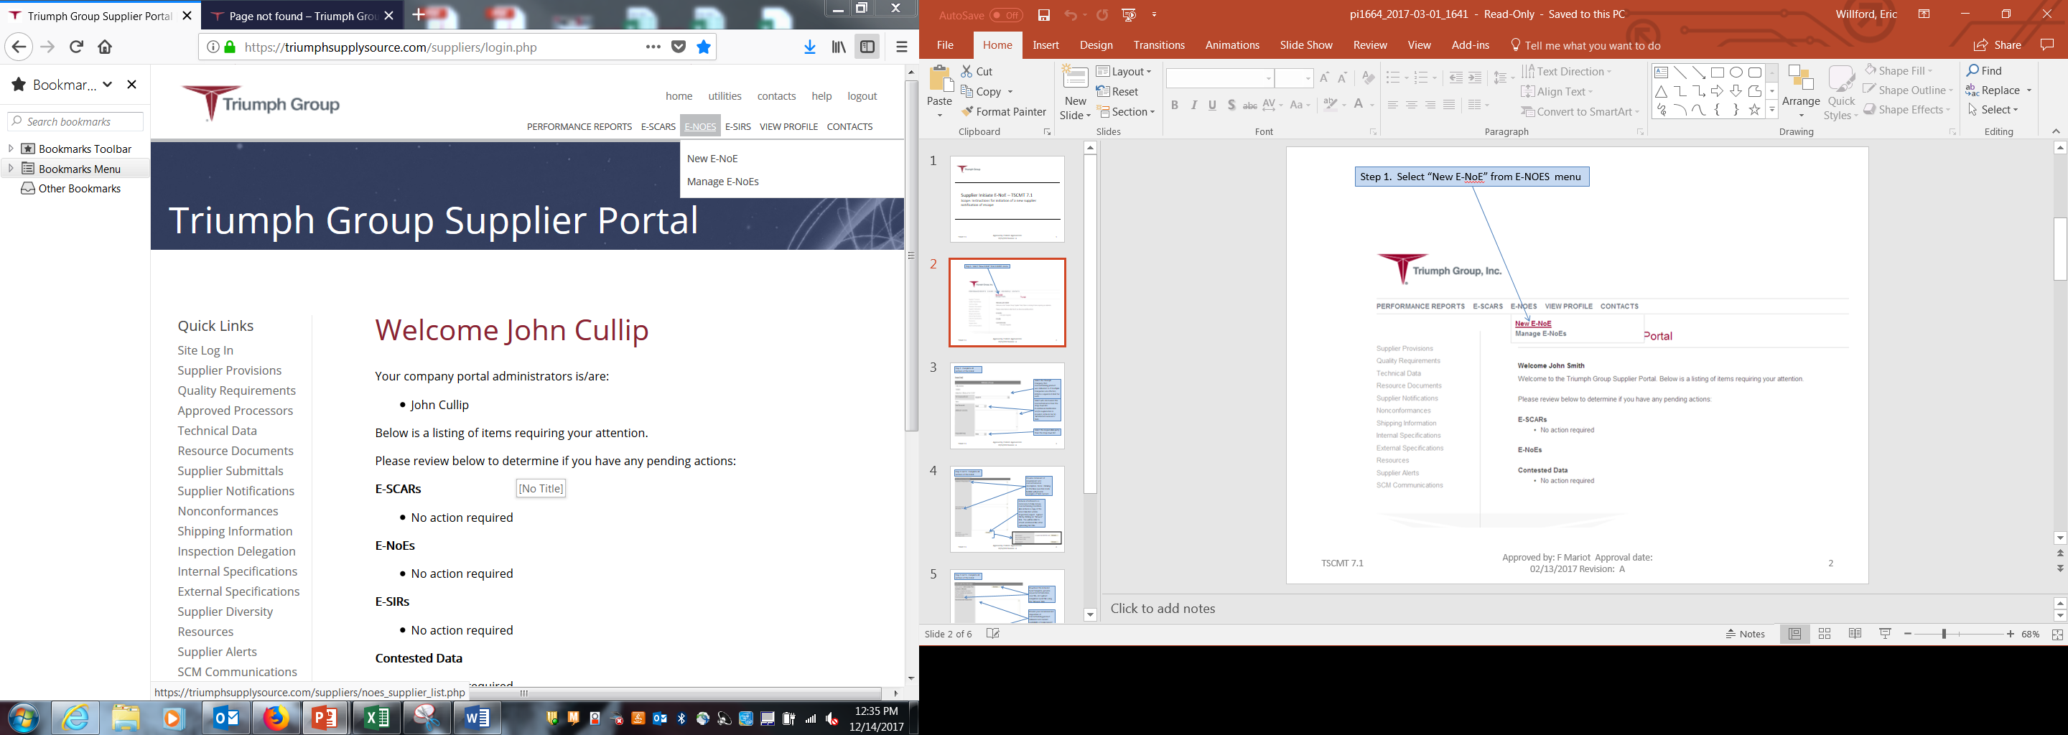
Step 1. Select “New E-NOE” from E-NOES menu

Slide 3
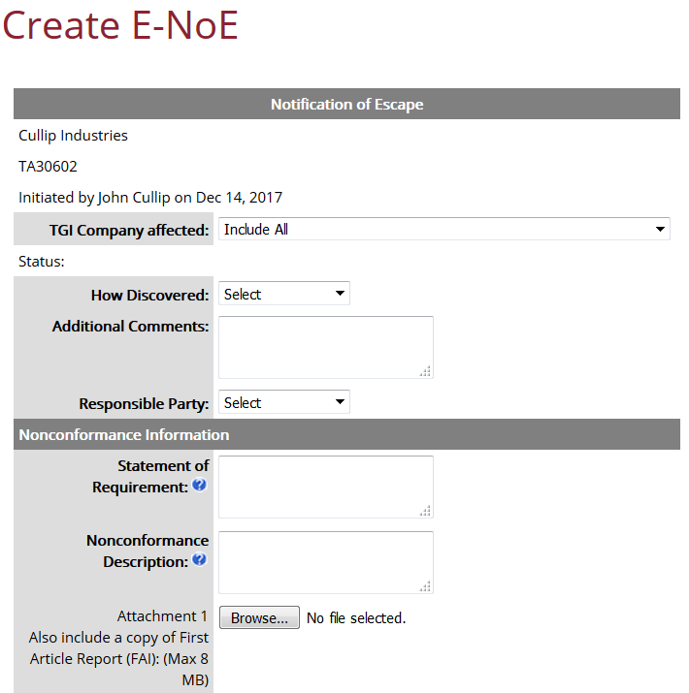
Step 2. Complete all sections of the E-NOE
Select the Triumph Company that nonconforming product was delivered to. If multiple Companies are affected, initiate a separate E-NoE for each.
Select who discovered the nonconformance from the drop down list. If additional clarification and/or explanation is required, include text in “Additional Comments” field. Select Responsible Party from drop down list
Provide statement of requirement and nonconformance description. Note: Clicking on the blue question mark bubble will provide examples of field content.
Include attachments as necessary to help convey nonconforming condition. Also include a copy of the latest FAI (first article inspection) report.

Slide 4
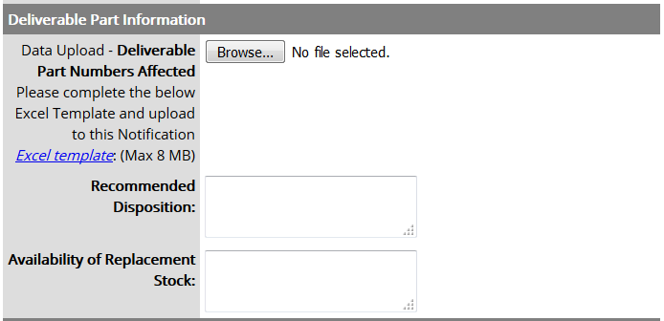
Step 2 cont’d. Complete all sections of the E-NOE
Download the included Excel Template, provide requested information, save file, and upload completed excel file using the “Browse” link
Provide your recommended disposition of nonconforming product delivered and current availability of replacement product.

Slide 5
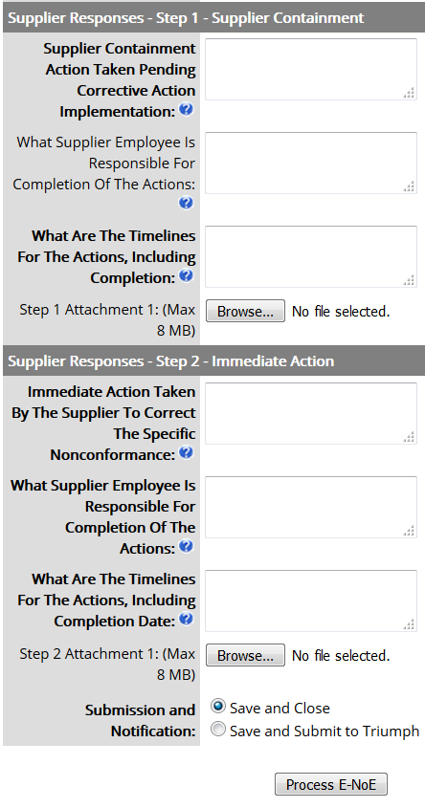
Step 2 cont’d. Complete all sections of the E-NOE
Provide requested information in Step 1 – Supplier Containment fields.
Provide attachments as required to support response.
Provide requested information in Step 2 – Immediate Action fields.
Provide attachments as required to support response.
If not complete, select “Save and Close”, NOE will display with a saved status on suppliers home page.
If complete, select “Save and Submit to Triumph.”
Click on “Process E-NOE”

