Slide 1
Supplier Response to E-SCAR – TSCMT 2.2 Scope: Instructions for supplier responding to a request for corrective action

Slide 2
The supplier’s Quality contact will receive an e-mail notification that a request for corrective action has been initiated requiring action. You can access the Triumph Group supplier portal by clicking on the imbedded link as noted.
Step 1: Log in to the portal with your username and password

Slide 3
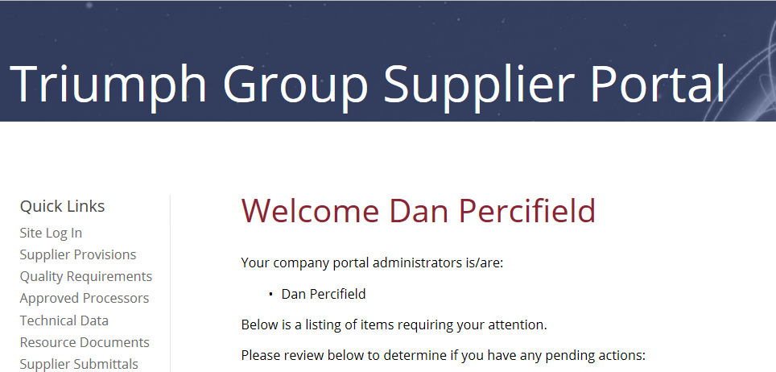
Once logged in, the E-SCAR will be posted to your home page indicating E-SCAR type, action and response due date. You can access the E-SCAR by clicking on the hyperlink

Slide 4
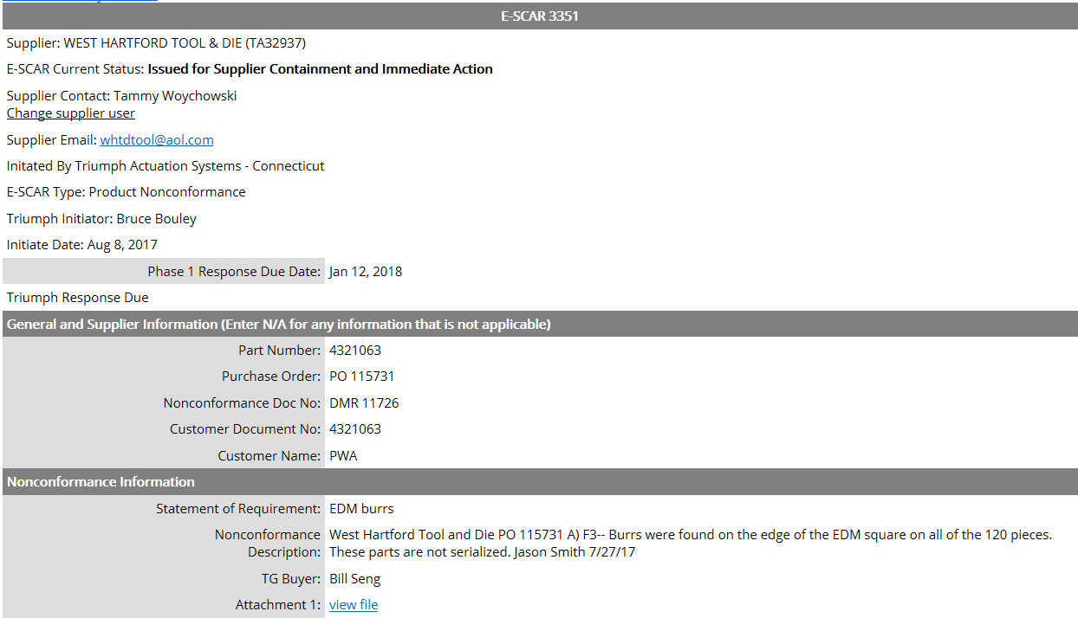
After review of nonconformance information, complete Step 1 – Supplier Containment, and Step 2 – Immediate Action. If you are being requested a Phase 1 response, go to slide 5. If you are being requested a Phase 2 response , complete E-SCAR Phase 2 – Corrective Action response sections, go to slide 8.

Slide 5
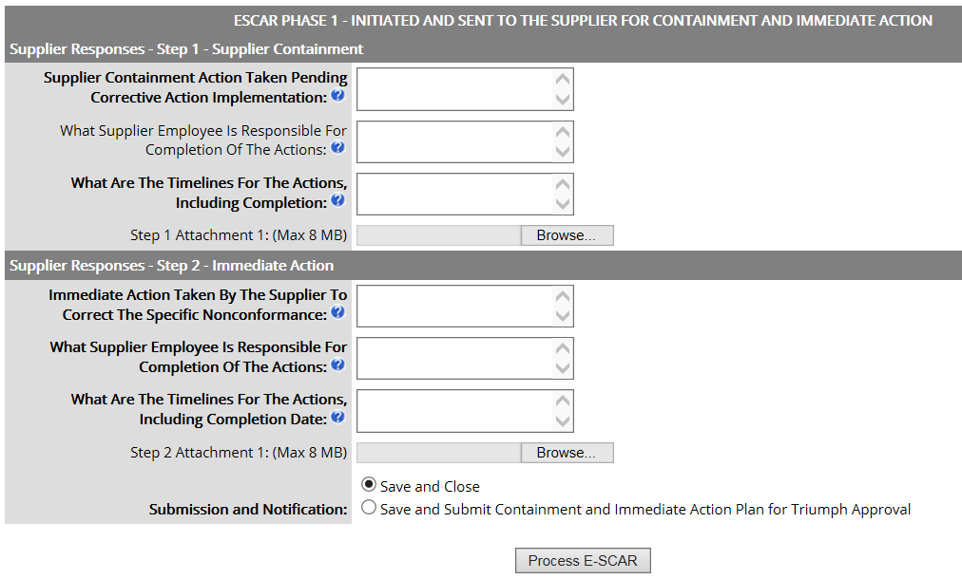
1. Complete Step 1 & Step 2 sections with requested information. The blue question marks provide additional explanation of required content.
Add attachments of objective evidence supporting actions taken. Click the “Browse” link to search for files to be attached. You will be given the opportunity to add additional attachments as each file is uploaded
3. You can choose to “Save and Close” to continue later, or if complete, then select “Save and Submit” option. Then Process E-SCAR to transmit to Triumph

Slide 6
1. Complete all sections with requested information. The blue question marks provide additional explanation of required content.
2. Select the RCCA methodology used to determine root cause
3. Insert Root Cause, Contributing Cause Statements in appropriate boxes .
4. Select the applicable cause codes from the drop-down list
5. Attach files that reflect methodology used. Once a file is selected, the system will allow for two additional attachments

Slide 7
1. Select the date from the calendar icon link when all corrective actions will have been completed and implemented.
2. You can choose to “Save and Close” to continue later, or if complete, then select “Save and Submit” option. Click on “Update and Save E-SCAR” link to transmit to Triumph.

Slide 8
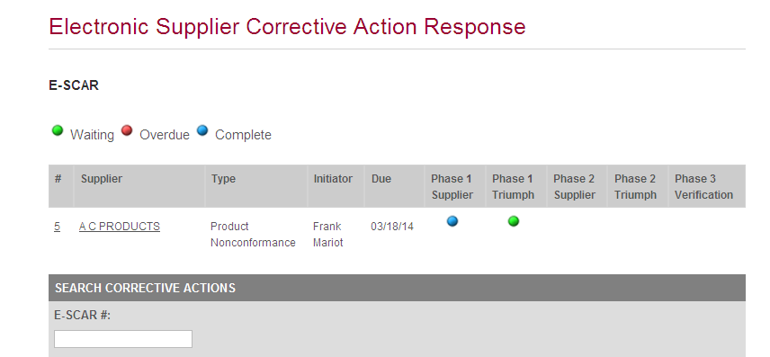
To view all E-SCAR status, select “E-SCARS” from the menu list. Open E-SCARS will appear with their current status. The color indicator reflects current status and location of the E-SCAR. In the example below, the E-SCAR is in Phase 1 response mode at the supplier, and since the color is green, the response is not delinquent.
From this page you can access the E-SCAR or the supplier’s profile by clicking on the underlined links. You can see, that after the E-SCAR has been submitted, the Phase 1 Supplier status displays “Blue” for completed action.

