Slide 1
Supplier View of Supplier Profile – TSCMT 5.12 Scope: Displays and explains content of the supplier profile

Slide 2
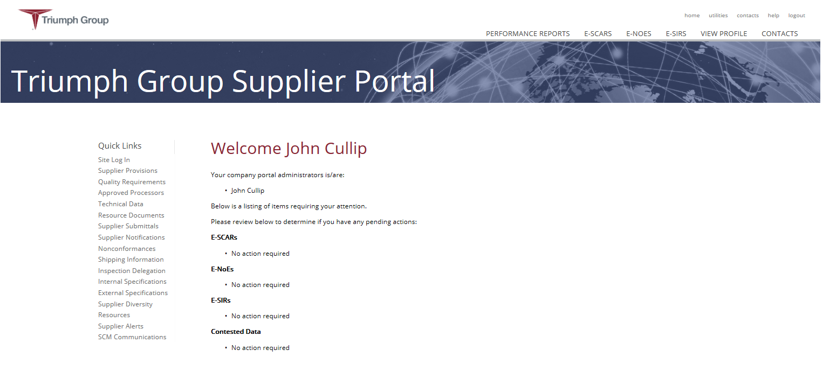
Step 1. Log on to portal, then click on “VIEW PROFILE”

Slide 3
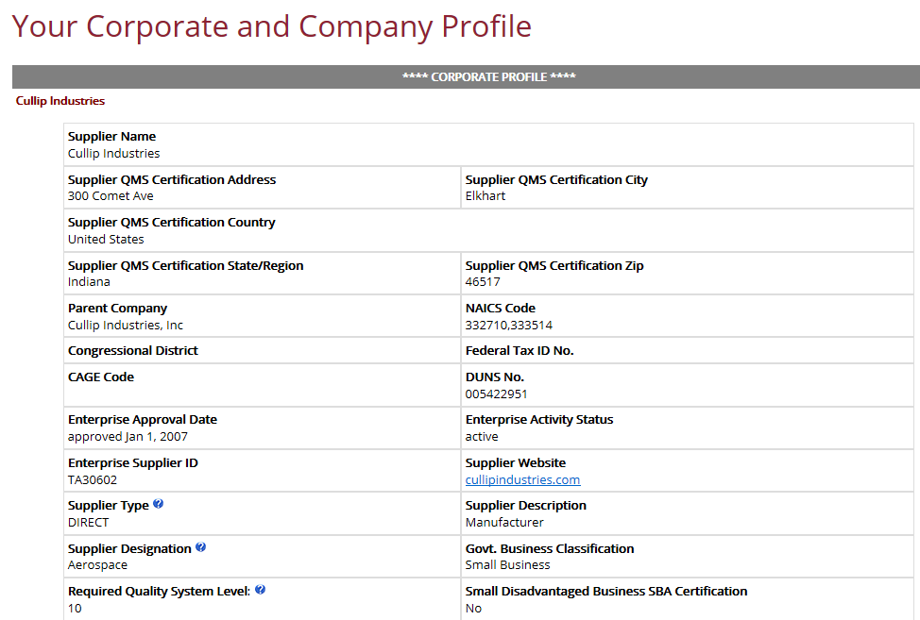
Corporate profile information is displayed first
The address noted here is the suppliers main office address. Typically, it reflects the address that is noted on the suppliers 3rd party QMS certificate as primary, or central if the supplier has multiple addresses on the cert.
Majority of these fields are self-explanatory.
For more information on a certain field, you can click on the question mark adjacent to the field label.

Slide 4
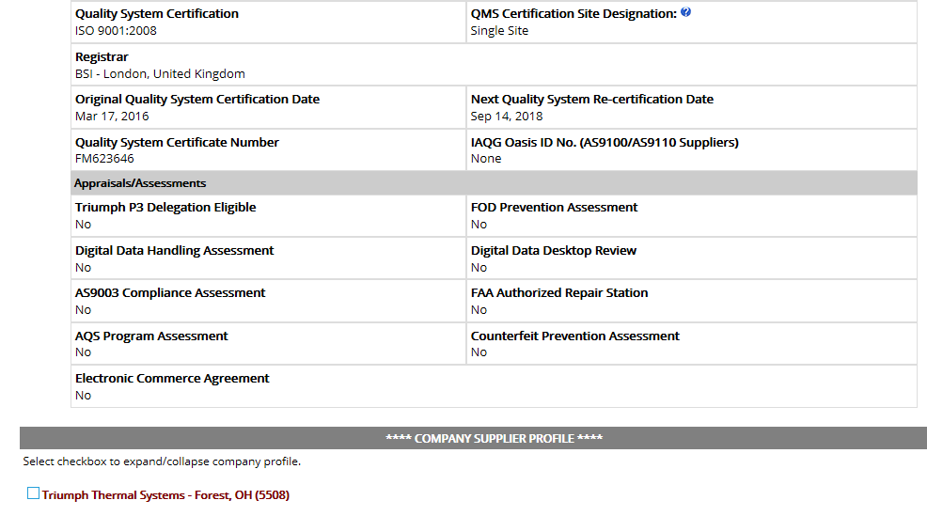
Continuation of Corporate supplier information:
The Company Supplier Profile section will display all of the Triumph Group Companies that may be doing business with the supplier. To expand the information associated with a specific Company click in the box adjacent to the Unit name.

Slide 5
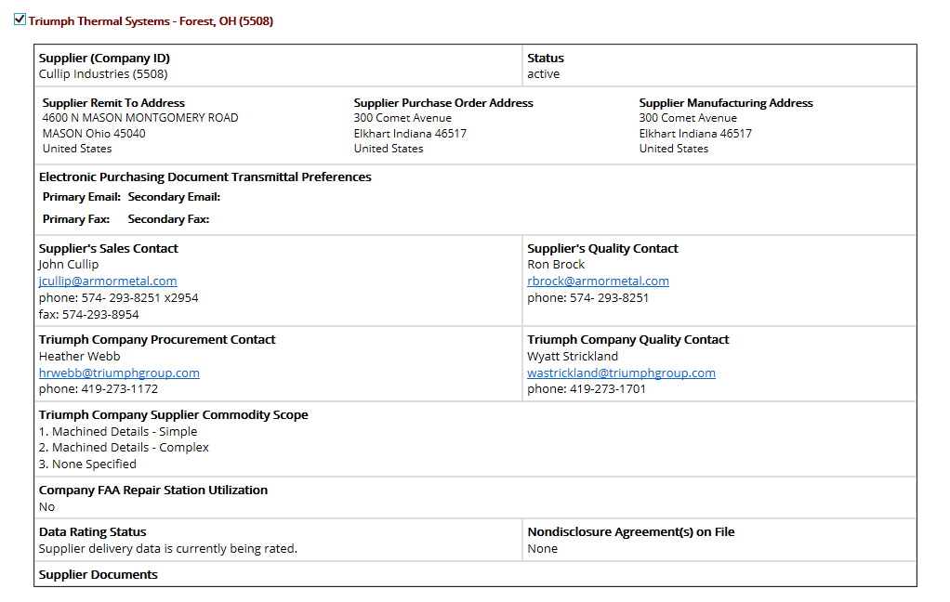
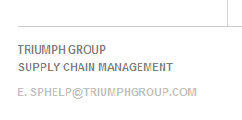
The “Supplier Company ID” - to the right of the supplier name is the Triumph Company's internal supplier ID number, as may be noted on purchase orders and other communications
Display of the Business Unit supplier profile information
Contact your Triumph Business Unit Procurement or Quality Contact to request any update to the information displayed. If no contact is listed, you can send an e-mail to the address displayed in the lower left-hand corner of the portal web page (click on link).

