Slide 1
Left Margin Menu Site Navigation – TSCMT 6.14 Scope: Navigation and Content of Supplier Portal Left Margin Menus and Sub Menus

Slide 2
This training covers the basics of the Left Margin Menu and Sub Menu structure. The illustrations provided on the subsequent slides contains content examples and does not illustrate every item available in the menu structure.
Explore the Supplier Portal’s current menu structure for additional information and content.
Additional Web Portal Overview Presentations are available under “Resource Documents/Portal Overview Presentations” menu path

Slide 3
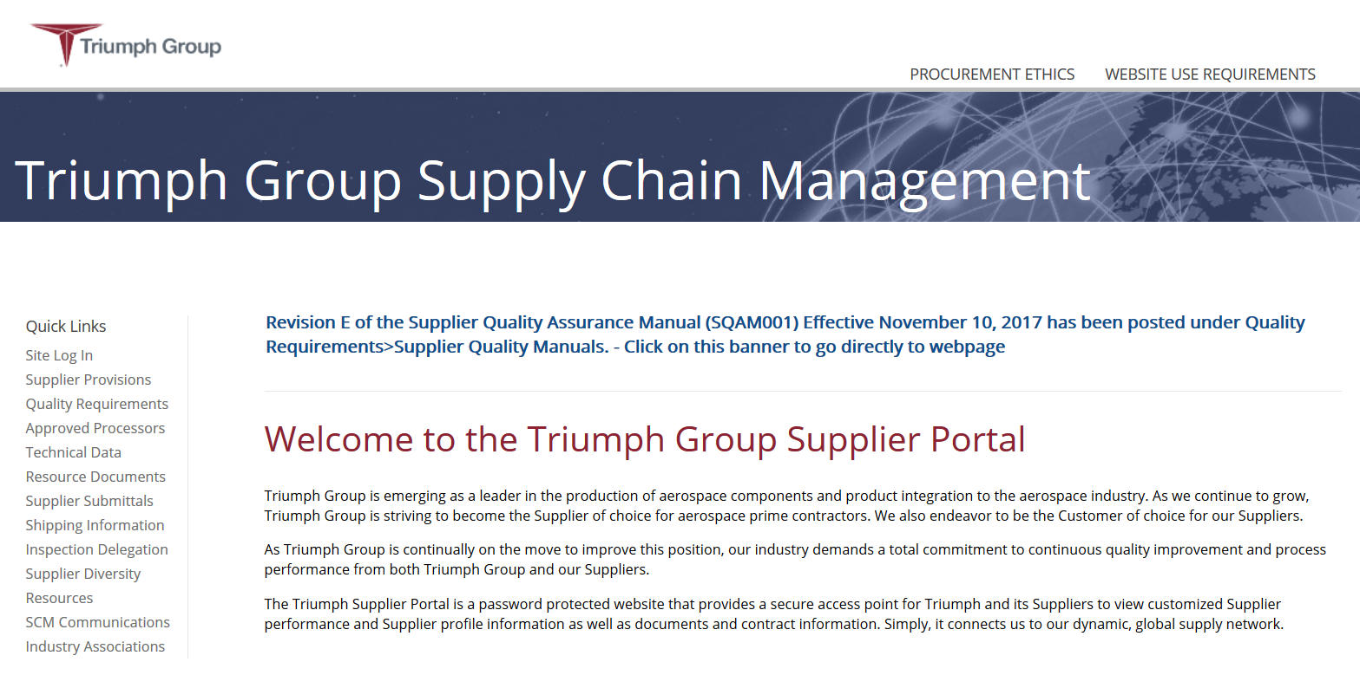
Fixed menu items that contain general information that does not change. Note that the Document Library has been removed from the Top Margin Menu and has been placed in the Left Margin Menu under different categories depending upon the subject matter.
The Left Margin Menu contain content that can change, Triumph Supplier Quality controls the nomenclatures, the order and the content. The menu content can vary depending upon needs and conditions:
Not logged in – Visible information is open to all
Logged in as a supplier – Information that is needed by the supplier
Logged in as Triumph Employee – Information that we have chosen to be available only to Triumph employees

Slide 4
Notice that the Left Margin Menu content changes depending upon your log in status
For example, even the sub menu content can be different depending upon you log in status. Actual content may vary from these examples.
Main Menu -
Not logged in, open to the public
Main Menu -
Logged in as Triumph employee
Main Menu -
Logged in as Supplier
Triumph sub menu
Supplier sub menu

Slide 5
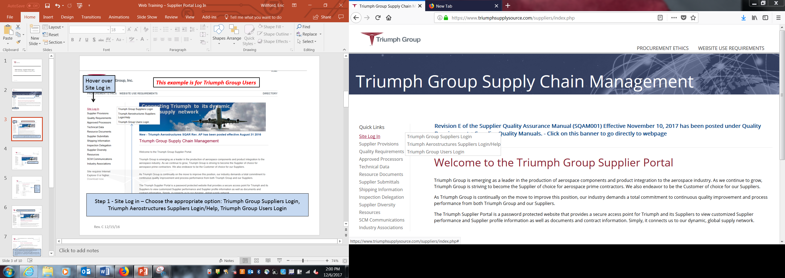
You and/or our suppliers can log into the portal as either a Triumph supplier/user or a Triumph Aerostructures supplier/user. We have yet to move all functionality of the Triumph Aerostructures site over to the Triumph site so we will continue to have two log in options.

Slide 6
Portions of the Triumph Aerostructures site will continue to be utilized by the Triumph Aerostructures Sites. These tools will still require supplier log in credentials to the Triumph Aerostructures Supplier Portal.
MESNC (Triumph Aerostructures – Vought Aircraft Division Nonconformance System)
SCARTS (Triumph Aerostructures - Vought Aircraft Division Supplier Corrective Action System)
SIR (Triumph Aerostructures - Vought Aircraft Division Supplier Information Request) Technical Engineering Data
When all functionality is replicated on the Triumph site, the Triumph Aerostructures access will be removed.

Slide 7
Sub Menu Structure – Items listed on the Left Margin Menu have “Sub Menu” items that drill down to more specific information concerning the Left Margin Menu topics
Main menu structure
The “Sub Menu” structure contains links to additional pages. Triumph Supplier Quality controls the labeling and content of the links and the associated pages.
As an example, under the main menu, you can choose “Supplier Provisions”. That Left Margin Menu link takes you to a listing of Sub Menu items under the “Supplier Provisions” link. This link contains the Triumph Group General Terms and Conditions, Specific Company Requirements and Historical Terms and Conditions

Slide 8
In the case of “Specific Company Requirements ”, each Triumph Company will now have the ability to post Specific Requirements to Terms and Conditions to a central location that is easy for suppliers to access.

Slide 9
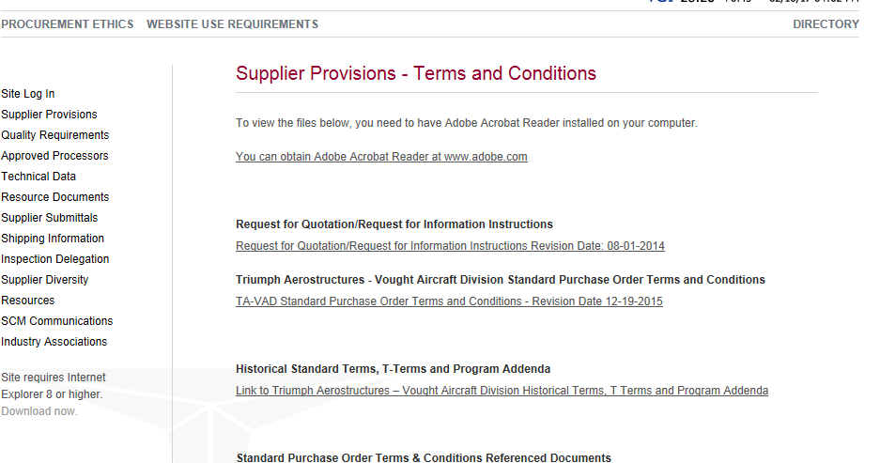
We can provide any specific wording you want on your page or keep it as standard text. You provide Triumph SQA with the specific documents and they post them for you. The documents are automatically linked with the revision level and effective date.

Slide 10
This training covered the basics of the Left Margin Menu and Sub Menu structure. The illustrations provided on the enclosed slides contains content examples and does note illustrate every item available in the menu structure.
Continue to explore the Supplier Portal’s current menu structure for additional information and content.

